Slide 1




Towards Efficient 𝑘-Mer Set Operations via
Function-Assigned Masked Superstrings
Ondřej Sladký, Pavel Veselý & Karel Břinda
Prague Stringology Conference
25.8.2025
1

Slide 2
𝑘-mer sets are core in computational biology
𝑘-mers = 𝑘-long substrings of genomic data
GGACTGCTACCGATA… → { GGA, GAC, ACT, … }
Central in alignment-free methods
Metagenomic classification
[Wood&Salzberg, Genom. Biol., 2014]
Large-scale data search
[Bradley&al., Nat.Biotechnol., 2019]
Infectious disease diagnostics
[Břinda&al., Nat. Microbiol., 2020]
Characteristics of 𝑘-mer sets in comp. bio.:
𝑘: from 3 to 100s (typical 31)
Size: from 10s to >>100G
Structure: depends on ① seq. tech. ② raw vs. asm ③ species ④ data reduction...

Slide 3
Our problem: efficient, queryable and dynamic 𝑘-mer structure
Our goal: Given a 𝑘-mer set K⊆Σ^{𝑘}, data structure fulfilling:
① Space-efficient: good compressive properties for practical datasets
Across all values of 𝑘, set sizes and structures
② Queries: fast presence/absence of a 𝑘-mer
Additionally: unique {0..|K|-1} hash of present 𝑘-mers
③ Dynamicity: 𝑘-mer set union, intersection, (symmetric) difference

Slide 4
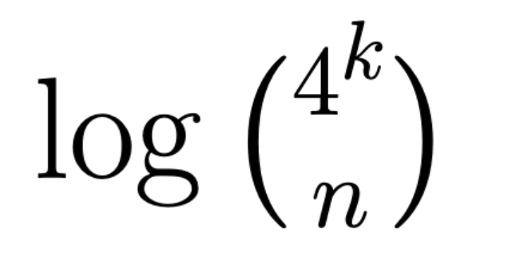
Information theory gives weak results for practical 𝑘-mer sets
𝑘-mer set K is size n subset of Σ^{𝑘} → ≥ bits for random set
[Conway&Bromage, Bioinf., 2011]
Space lower bound achieved by Conway-Bromage data structure
[Conway&Bromage, Bioinf., 2011]
Dynamized in Conway-Bromage-Lyndon (CBL)
[Martayan&el., Bioinf., 2024]
But: practical 𝑘-mer sets are non-random → invalidates lower bounds
4

Slide 5
State of the art: indexing using de Bruijn graphs
de Bruijn graph (dBG):
GGA
ACC
GAC
ACT
CGA
SBWT directly stores de Bruijn graphs by 𝑘-mer successors
[Alanko&al, ACDA, 2023]
dbgFM and SSHash store de Bruijn graph in form of SPSS/simplitigs
[Chikhi&al., J.Comp.Bio., 2021]
[Pibiri, Bioinf., 2022]
GGA
ACC
SPSS/simplitigs - compacted paths in dBG
GAC
ACT
CGA
[Rahman&Medvedev, JCB, 2021]
[Břinda&al., Genom.Biol., 2021]
CGA
CGACC
CGA
Good compressive properties for simple cases (e.g., human genome 𝑘=31)
But: not dynamic & inefficient with: pan-genomes, small 𝑘, sampling,...
5

Slide 6
Ingredients for a space-efficient dynamic 𝑘-mer index
① Masked superstrings for space-efficiency across practical datasets
[Sladký&Veselý&Břinda, RECOMB-seq, 2023]
② FMSI data structure for space-efficient 𝑘-mer queries
[Sladký&Veselý&Břinda, ISMB, 2025]
③ Generalization via 𝑓-MS for dynamic set operations

Slide 7
Compact 𝑘-mer set representation via superstrings
[Sladký&Veselý&Břinda, RECOMB-seq, 2023]
Key idea: 𝑘-mer set → shortest superstring + mask (coding false positives)
= shortest string containing 𝑘-mers as substrings
Example:
𝑘-mer set: {GGA, ACC, CGA, GAC, ACT}
superstring: GGACCGACT
more masks possible:
111010100
mask: 111011100
(max-one)
(min-one)
GAC
GGA present
CCG absent
Determining 𝑘-mer's presence:
① Get mask symbols at starting positions of each occurrence
Λ(GAC) = [1, 1]
② Check OR of the result is 1
OR([1, 1]) = 1
7

Slide 8

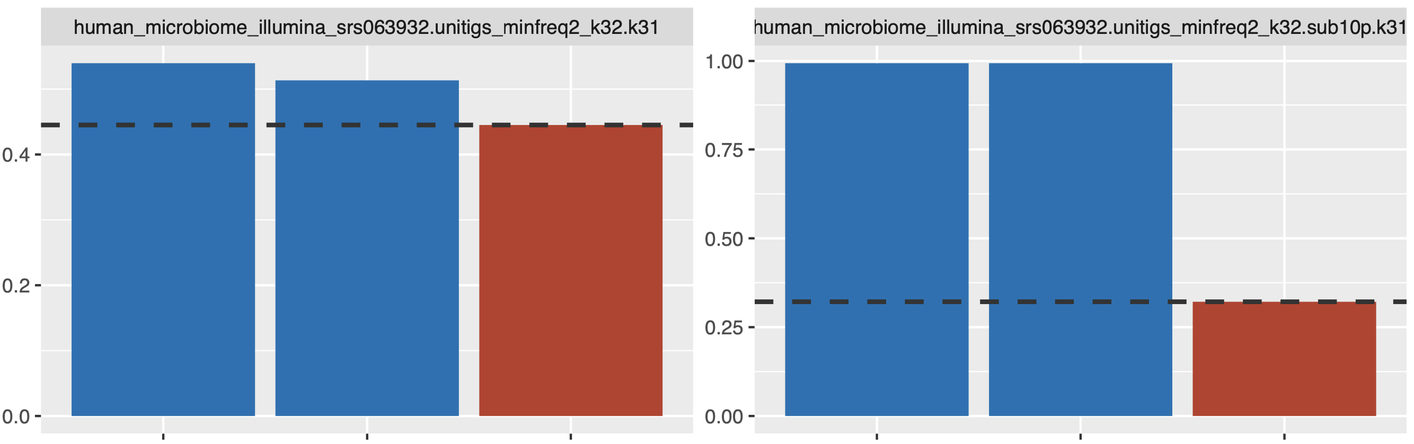
How to compute masked superstrings?
[Sladký&Veselý&Břinda, RECOMB-seq, 2023]
Complex problem – many possible objectives depending on applications
e.g., |S| + c [#1s in M]
Simplified version – the two-step optimization protocol:
① Compute 𝑘-mer superstring
​​ reduced from [Gallant&al., J.Comp.Sys.Sci., 1980]
• Shortest 𝑘-mer superstring NP-hard
​​ implemented in KmerCamel
• Greedy superstrings in linear time
② Optimize 𝑘-mer mask
• Minimizing/maximizing # of 1s linear
Resulting superstrings are near-optimal for 𝑘-mer sets
Length [G]
H.tongue microbi. reads
10% sampl. H.m.reads
S_{O}- simplitigs (optimal)
[Schmidt&Alanko, AMB, 2023]
length lower bound
(dashed)
M_{G}- matchtigs (greedy; SPSS w repetitions)
[Schmidt&al., Gen. Biol., 2023]
MS_{G} – greedy masked superstrings
8
S_{O}
M_{G}
MS_{G}
S_{O}
M_{G}
MS_{G}

Slide 9
Our results

Slide 10
How to dynamize masked superstrings?
(S₁, M₁) ∘ (S₂, M₂) → (S, M)
K₁ K₂ → K₁ op K₂
AAC
110
AAG
110
AACAAG
110110
→
+
Union easy – concatenate masked superstrings
∪
=
{AA,AC}
{AA,AG}
{AA,AC,AG}
Problem: intersection, symm/set difference & combinations

Slide 11
Solution: function-assigned masked superstrings
mask: 111011100
superstring: GGACCGACT
Key idea: generalize OR with any suitable demasking function 𝑓
𝑓: {0, 1}* → {0, 1, invalid}; symmetric; 𝑓(ϵ) = 0
① Get mask symbols at starting positions of each occurrence
Λ(GAC) = [1, 1]
② Check 𝑓 of the result is 1
𝑓 = OR: 𝑓([1, 1]) = 1
𝑓 = XOR: 𝑓([1, 1]) = 0
Definition: 𝑓-masked superstring: triplet (𝑓, S, M)
Represented 𝑘-mer set K = {Q | 𝑓(Λ(S, M, Q) = 1}

Slide 12
Building block operations: recast & concat
Recast: for (𝑓_{i}, S, M) and 𝑓_{o}: return (𝑓_{o}, S, M') representing same set
S does not change
Possible for large class of 𝑓s – comprehensive functions
For 𝑓s used in this work – minimization/maximization of 1s works
Example:
𝑓_{o} = XOR
𝑓_{i} = OR
→
S = GGACCGACT
S = GGACCGACT
M' = 111010100
M = 111011100
Concat: for two 𝑓_{i}-MS and 𝑓_{o}: return (𝑓_{o}, S₁+S₂, M₁+M₂)
𝑓_{i}
𝑓_{i}
Example:
𝑓_{o}
S₁ = GGACC
S₂ = GACT
S = GGACCGACT
+
→
M₁ = 11100
M₂ = 1100
M = 111001100

Slide 13
𝑘-mer set operations via concat on 𝑓-MS
Union: OR→OR concat (as in the default MS)
[Sladký&Veselý&Břinda, RECOMB-seq, 2023]
OR is the only comprehensive 𝑓 acting as union
Symm. diff.: XOR→XOR concat
AAC
110
AAG
110
AACAAG
110110
→
+
Intersection: no same 𝑓→𝑓 concat existing
∪
=
{AA,AC}
{AA,AG}
{AA,AC,AG}
=
oon→thr₂ concat works
²
Δ
{AA,AC}
{AA,AG}
{AC,AG}
One 1: 1
No 1s: 0
More 1s: inv.
∩
Two1s: 1
Less/more 1s: 0
=
{AA,AC}
{AA,AG}
{AA}
Other operations: (set diff., ...): by chaining above

Slide 14
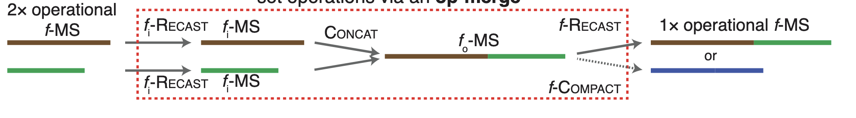
Workflow with 𝑓-masked superstrings
union/symm.diff./intersection

Slide 15
How to answer queries on 𝑓-masked superstrings?

Slide 16
The core of masked superstring indexing: Masked BWT
[Sladký&Veselý&Břinda, ISMB, 2025]
= BWT + SA-transformed mask
Burrows-Wheeler matrix of superstring
Glued mask symbols to superstring chars
$ G G A C C G A C T
A C C G A C T $ G G
A C T $ G G A C C G
C C G A C T $ G G A
C G A C T $ G G A C
C T $ G G A C C G A
G A C C G A C T $ G
G A C T $ G G A C C
G G A C C G A C T $
T $ G G A C C G A C
$ 1 1 1 0 1 0 1 0 0
1 0 1 0 1 0 0 $ 1 1
1 0 0 $ 1 1 1 0 1 0
0 1 0 1 0 0 $ 1 1 1
1 0 1 0 0 $ 1 1 1 0
0 0 $ 1 1 1 0 1 0 1
1 1 0 1 0 1 0 0 $ 1
0 1 0 0 $ 1 1 1 0 1
1 1 1 0 1 0 1 0 0 $
0 $ 1 1 1 0 1 0 1 0
BWT of S
= last superstring column
[Burrows&Wheeler, 1994]
SA-transformed mask M'
= first mask column
Masked superstring:
G G A C C G A C T $
1 1 1 0 1 0 1 0 0 $
Enables querying superstring's 𝑘-mers while filtering false positive

Slide 17
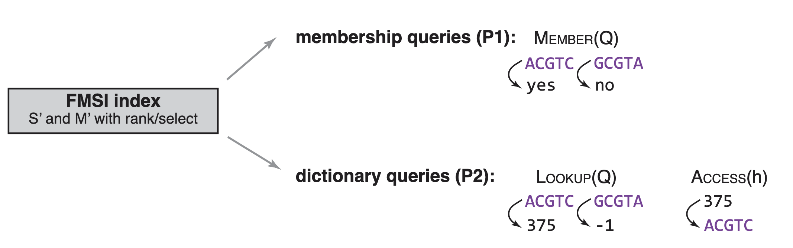

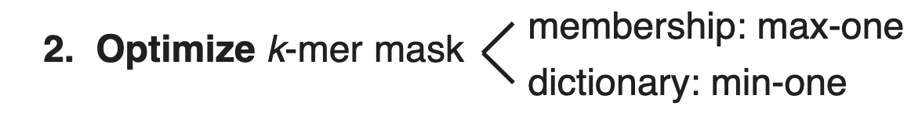
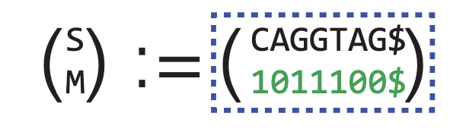
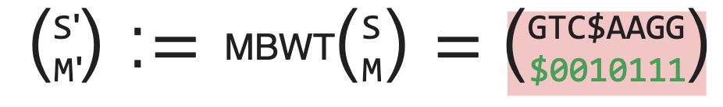
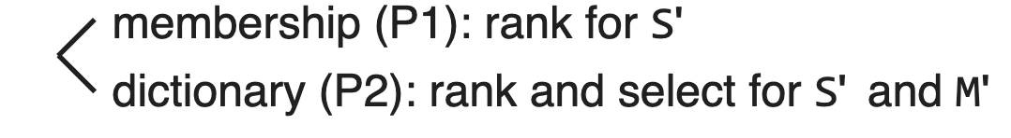
Querying masked superstrings: FMSI data structure
[Sladký&Veselý&Břinda, ISMB, 2025]
What:
How:
Theoretical properties:
Space: for any 𝑘-mer set: 2|S| + H₀(M) bits
Queries in O(𝑘) time

Slide 18
Extending the FMSI index to 𝑓-MS: queries & dynamicity
Membership queries: of k-mer Q for arbitrary 𝑓
① Retrieve Q's SA interval
[Sladký&Veselý&Břinda, ISMB, 2025]
② Ask rank to get a permutation π of Λ(S, M, Q) in O(1)
③ Evaluate 𝑓(π(Λ(S, M, Q))) = 𝑓(Λ(S, M, Q))
Recast: in FMSI in O(|S| + 𝑘|K'|)
① For each position, retrieve starting 𝑘-mer
② Check if it is present & set mask symbols accordingly
Concat: in O(|S₁| + |S₂|) time
① Merge BWT using any algorithm for BWT merging
② Handle masks as in FMSI construction
[Sladký&Veselý&Břinda, ISMB, 2025]

Slide 19
Proof-of-concept experiment: low query memory after set ops
CBL
FMSI
C. elegans, 𝑘=23
(91M k-mers)
C. briggsae, 𝑘=23
(91M k-mers)
[Martayan&el., Bioinf., 2024]
[bits/𝑘-mer]
[bits/𝑘-mer]
Index
Index
Query
Genomes:
83
2.7
Union:
59
2.5
Set operation
Symm.diff.:
59
2.6
Merged index
Query
Intersection:
420
524
43
Compacted:

Slide 20
Conclusions
Summary:
𝑓-MS generalize masked superstrings by adding demasking function 𝑓
Concat & recast enable arbitrary set operations on masked superstrings
Combining with FMSI: a dynamic 𝑘-mer index with most space-efficient queries
Limitations & future work:
Practically fast and space-efficient algorithms for BWT merging
Fast algorithm for mask Recast directly in the SA coordinates
Single insertions and deletions faster than w/ union/set.diff.

Slide 21
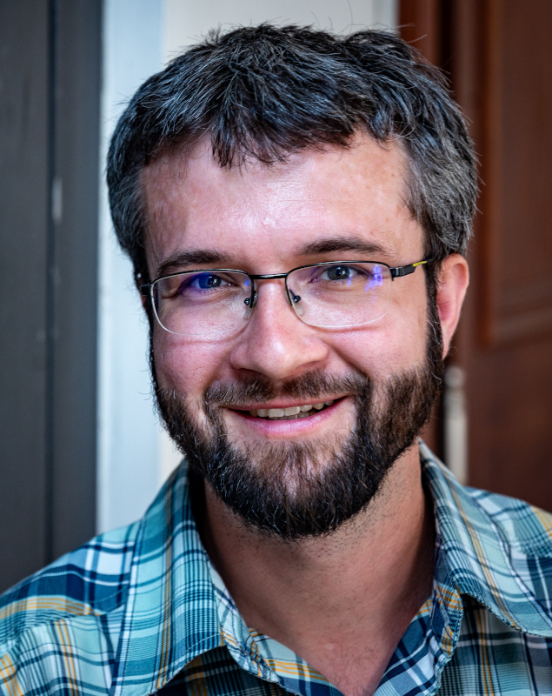
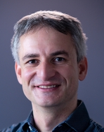
Thank you for your attention!
Pavel Veselý
Karel Břinda

Slide 22
Unused slides

Slide 23
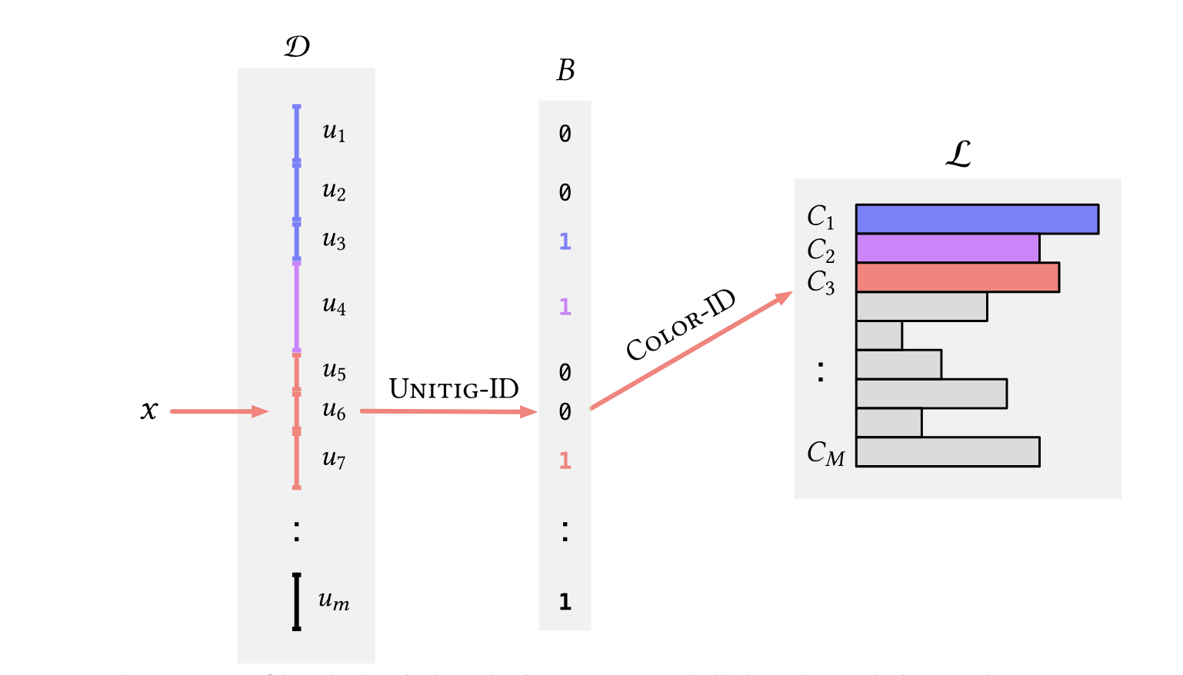
Colored k-mer sets rely on efficient single set indexing
Figure from Fulgor [Fan&al., AMB, 2024]

Slide 24
Dictionary and membership queries in FMSI
① Get k-mer's SA interval (i,j) from BWT
Standard backwards search
[Ferragina&Manzini, FOCS, 2000]
A C C G A C T $ G G
A C T $ G G A C C G
C C G A C T $ G G A
C G A C T $ G G A C
C T $ G G A C C G A
G A C C G A C T $ G
G A C T $ G G A C C
G G A C C G A C T $
T $ G G A C C G A C
1 0 1 0 1 0 0 $ 1 1
1 0 0 $ 1 1 1 0 1 0
0 1 0 1 0 0 $ 1 1 1
1 0 1 0 0 $ 1 1 1 0
0 0 $ 1 1 1 0 1 0 1
1 1 0 1 0 1 0 0 $ 1
0 1 0 0 $ 1 1 1 0 1
1 1 1 0 1 0 1 0 0 $
0 $ 1 1 1 0 1 0 1 0
② If i≠j, verify true presence via SA-transformed mask M'
Membership: check M'[i] = 1
Dictionary: check M'.rank(i) ≠ M'.rank(j)
GAC
query
③ If present, return True or 0..|K|-1 hash
membership
dictionary
return M'.rank(i)
Time complexity: O(𝑘)
Streaming: next k-mer O(1) via kLCP and saturating counters
[Salikhov, PhD thesis, 2017]
Implemented in the FMSI program
github.com/OndrejSladky/fmsi

Slide 25
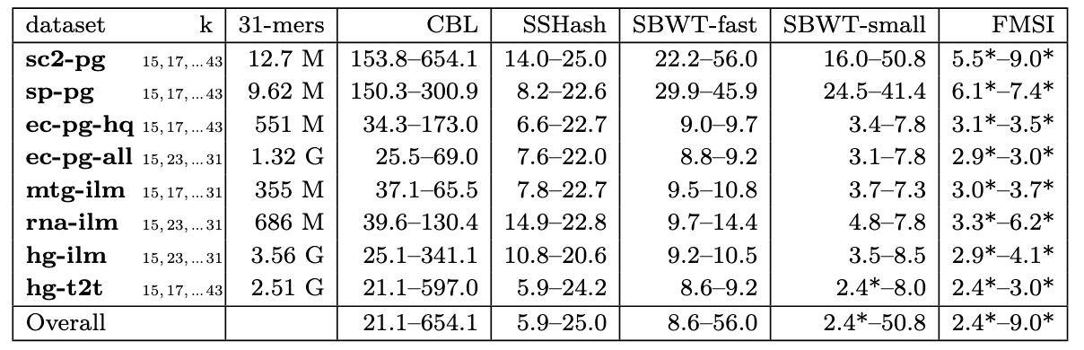
Results: FMSI is the most space-efficient 𝑘-mer set index
• ranges of datasets​
• ranges of 𝑘
Evaluations through:
• ranges of methods​
[Martayan&al, Bioinf., 2024]
[Alanko&al, ACDA, 2023]
[Pibiri, Bioinf., 2022]
[query memory bits / canon. 𝑘-mer]
best values highlighted
Notes:
We compared our tool, FMSI, to three state-of-the-art indexes, CBL, SSHash and Spectral-Burrows-Wheeler Transform in two variants – SBWT-fast with the default hyper-parameter setting and SBWT-small with hyperparameters tuned for space-efficiency.
And; since the existing k-mer indexes are mostly optimized for model use cases such as human genome with k=31, we performed experimental evaluation on a range of datasets of various sizes including read and assembly datasets, for a range of k.
For each tool, we measured the range of bits of memory to answer queries per canonical k-mer in the reference dataset; and for all the datasets FMSI ouperformed all competing data structures.
As an example, consider the E.coli pan-genome from 661k bacteria database consisting of 1.3 billion k-mers. Here, CBL achieves 25 to 69 bits per k-mer, SSHash 7 to 22,

Slide 26
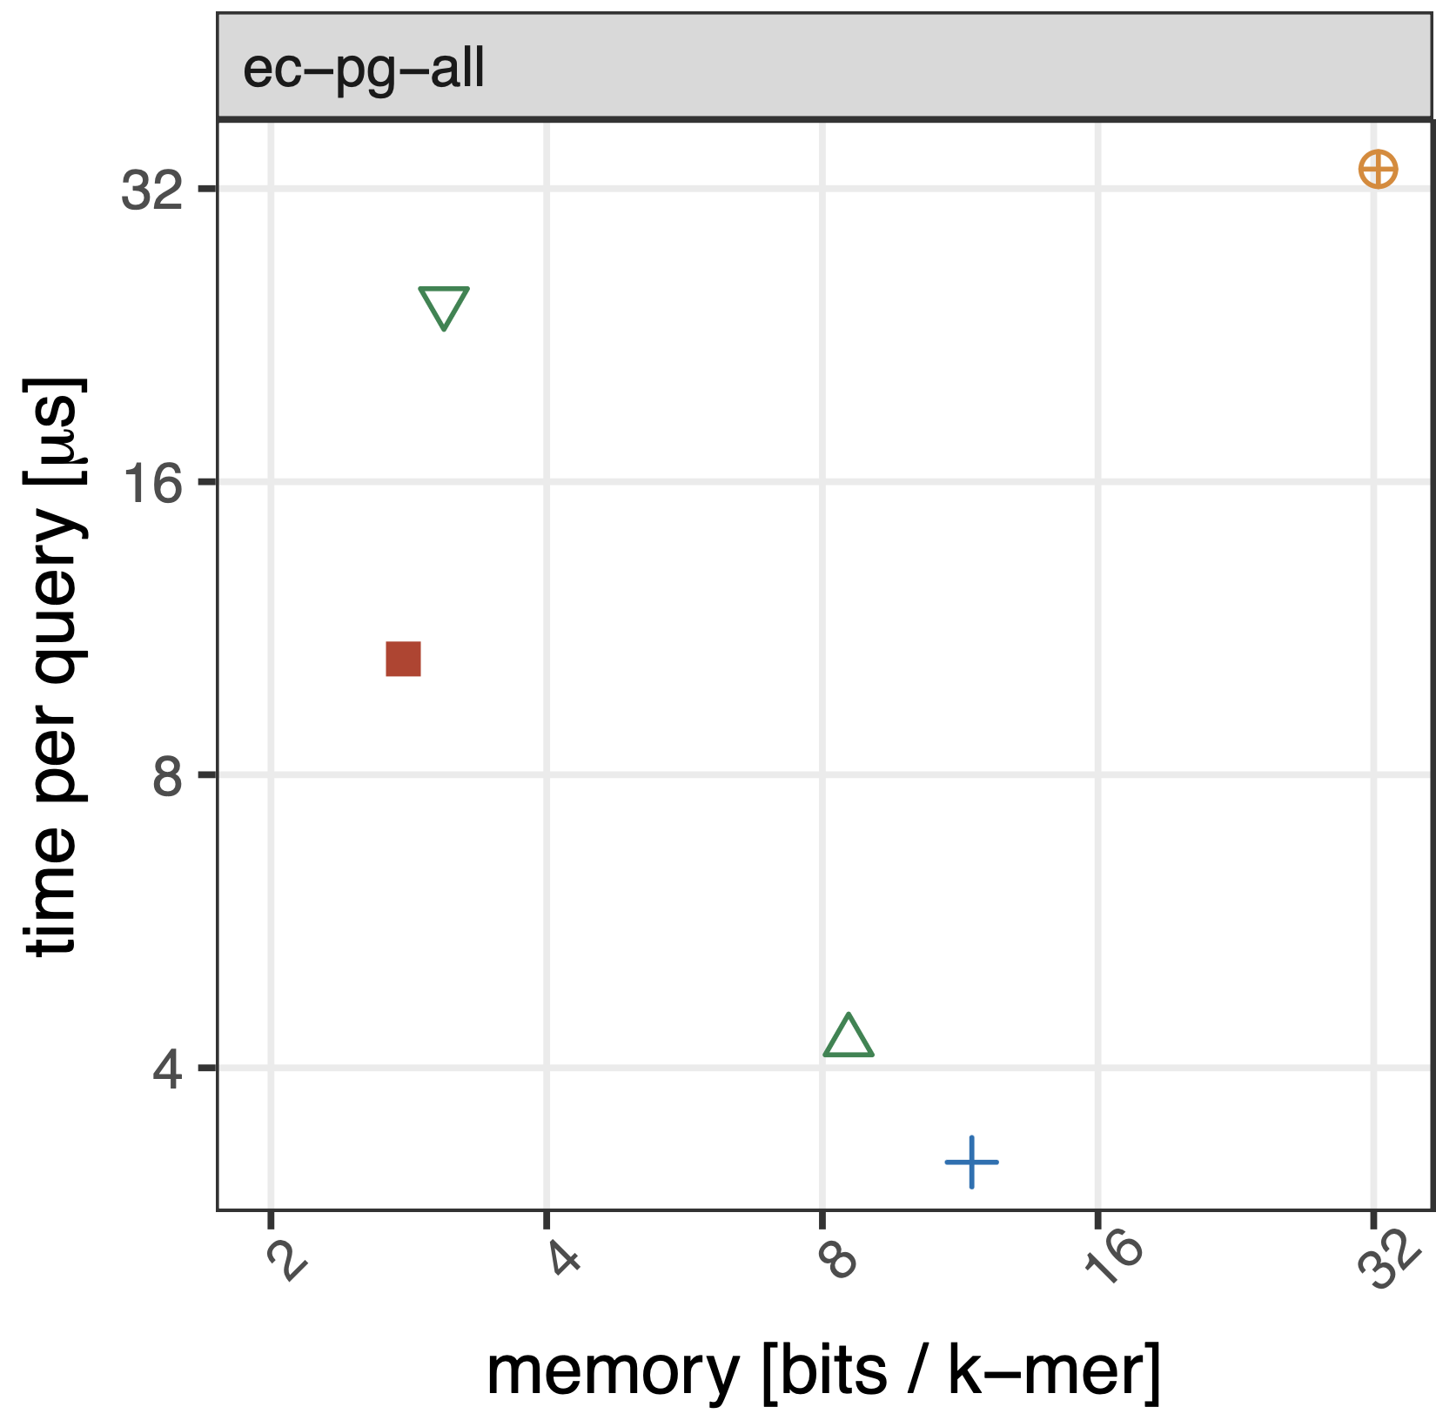





Results: FMSI retains competitive query time
E.coli pangenome (𝑘=23)

Slide 27
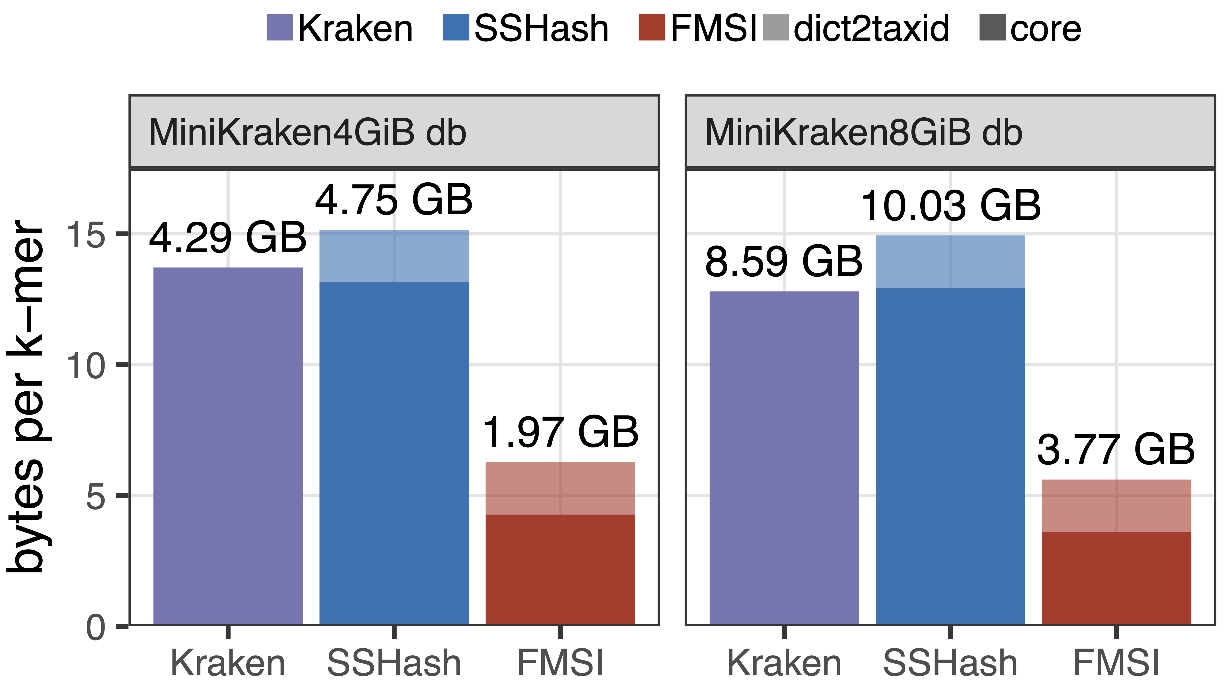
FMSI allows new applications: sampled k-mer sets
>𝟐× space improvement in MiniKraken LCA indexing
Dictionary queries on MiniKraken databases (4GiB&8GiB) from Kraken
[Wood&Salzberg, Genom. Biol., 2014]

