Slide 1
Computing
Maximal Palindromes and
Distinct Palindromes in a Trie
PSC2019
Mitsuru Funakoshi, Yuto Nakashima, Shunsuke Inenaga, Hideo Bannai, Masayuki Takeda
Kyushu University
Notes:
Thank you for the introduction.
I'm a master student from Kyushu University in Japan.
and these people are my supervisors.

Slide 2
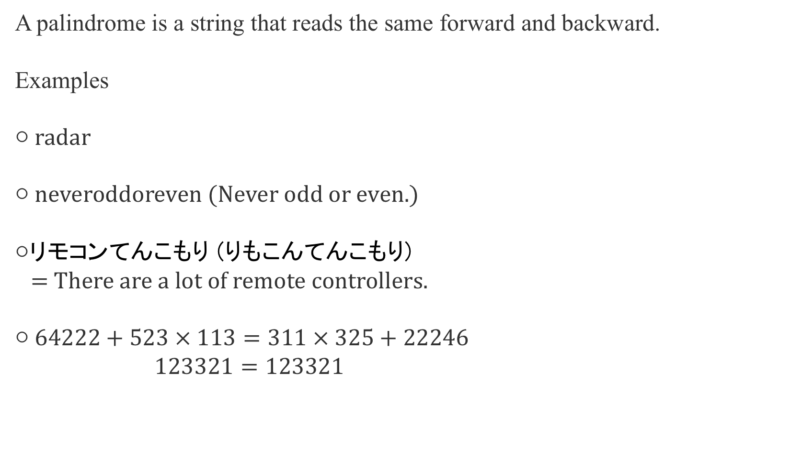
Palindromes
A palindrome is a string that reads the same forward and backward.
Examples
○ radar
○ neveroddoreven (Never odd or even.)
○リモコンてんこもり (りもこんてんこもり)
= There are a lot of remote controllers.
○ $64222+523 × 113=311 × 325+22246$
$123321=123321$
Notes:
This study is about palindromes.
A palindrome is a string that reads the same forward and backward.
Here are some examples of palindromes.
"radar" is a palindrome.
Also, ” neveroddoreven" is a palindrome.
This is a Japanese palindrome which means that
there are a lot of remote controllers. like this illustrasion.
The last example is this equation which is a palindrome as a string.
I remark that this equation is mathematically correct.
What is more interesting about this palindrome is that the calculated values are also palindromes,
123321 and so is this equation!!!
I made these palindromic formulas by myself without a computer.

Slide 3
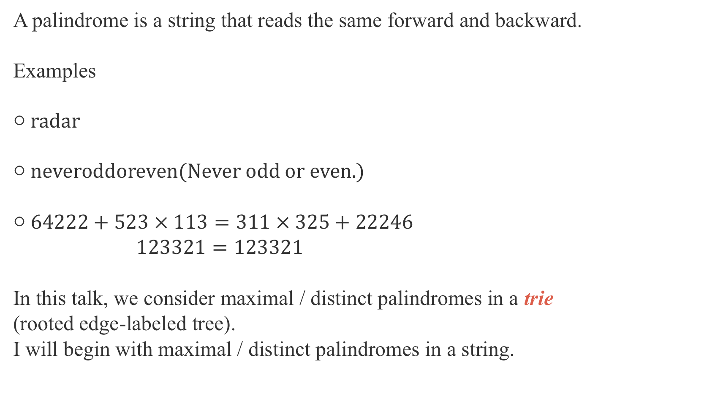
Palindromes
A palindrome is a string that reads the same forward and backward.
Examples
○ radar
○ neveroddoreven(Never odd or even.)
○ $64222+523 × 113=311 × 325+22246$
$123321=123321$
In this talk, we consider maximal / distinct palindromes in a trie
(rooted edge-labeled tree).
I will begin with maximal / distinct palindromes in a string.
Notes:
In this talk, we consider maximal palindromes and distinct palindromes in a trie (namely, rooted edge-labeled tree).
I will begin with maximal palindromes and distinct palindromes in a string,
and then generalize them to tries.

Slide 4
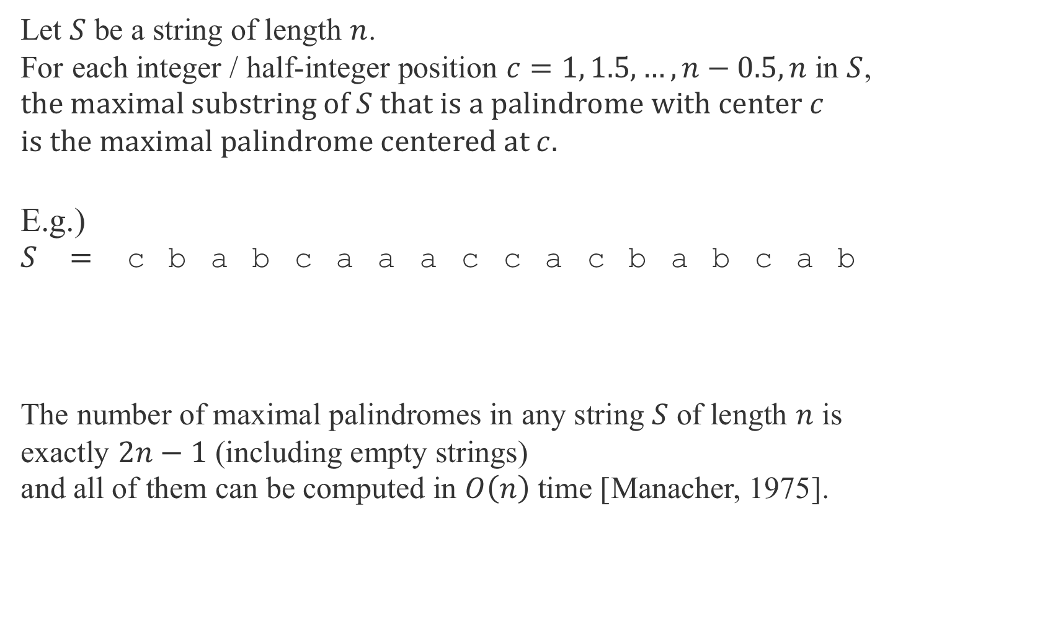
Maximal palindromes in a string
Let $S$ be a string of length $n$.
For each integer / half-integer position $c=1, 1.5, …,n−0.5, n$ in $S$,
the maximal substring of $S$ that is a palindrome with center $c$
is the maximal palindrome centered at $c$.
E.g.)
$S=$ cbabcaaaccacbabcab
The number of maximal palindromes in any string $S$ of length $n$ is
exactly $2n−1$ (including empty strings)
and all of them can be computed in $O\left(n\right)$ time [Manacher, 1975].
7
9.5
Notes:
Let S be a string of length n.
For each integer and half-integer position $c from1 to n$ in S,
the maximal substring of S that is a palindrome with center c
is the maximal palindrome centered at c.
Let me show some examples of maximal palindromes.
For example, the maximal palindrome for the center at position 7 is ”caaac" in this string S.
For another example, the maximal palindrome for the center at position 9.5 is "acca" in this string S.
The number of maximal palindromes in any string $S$ of length n is exactly $2n−1$ (including empty strings).
Manacher showed how to compute all maximal palindromes in S in linear time.

Slide 5

Distinct palindromes in a string
For a string $S$, let $D_{S}$ be the set of all distinct palindromes in $S$.
E.g.)
$S=$ cbabcaaaccacbabcab
$D_{S}=${ε,a,b,c,aa,cc,aaa,bab,cac,acca,
cbabc,caaac,acbabca}
Notes:
Next I will explain distinct palindromes in a string.
For a string 𝑆, let 𝐷_𝑆 be the set of all distinct palindromes in 𝑆.
For example, the set of distinct palindromes in this string S is this.
Epsilon is the empty string.
I remark that D_S can contain non maximal palindromes like this.
The maximum number of distinct palindromes in any string 𝑆
of length 𝑛 is at most 𝑛+1.
Groult et al. proved that all distinct palindromes in 𝑆 can be computed in linear time.

Slide 6

Distinct palindromes in a string
For a string $S$, let $D_{S}$ be the set of all distinct palindromes in $S$.
E.g.)
$S=$ cbabcaaaccacbabcab
$D_{S}=${ε,a,b,c,aa,cc,aaa,bab,cac,acca,
cbabc,caaac,acbabca}
Notes:
Next I will explain distinct palindromes in a string.
For a string 𝑆, let 𝐷_𝑆 be the set of all distinct palindromes in 𝑆.
For example, the set of distinct palindromes in this string S is this.
Epsilon is the empty string.
I remark that D_S can contain non maximal palindromes like this.
The maximum number of distinct palindromes in any string 𝑆
of length 𝑛 is at most 𝑛+1.
Groult et al. proved that all distinct palindromes in 𝑆 can be computed in linear time.

Slide 7
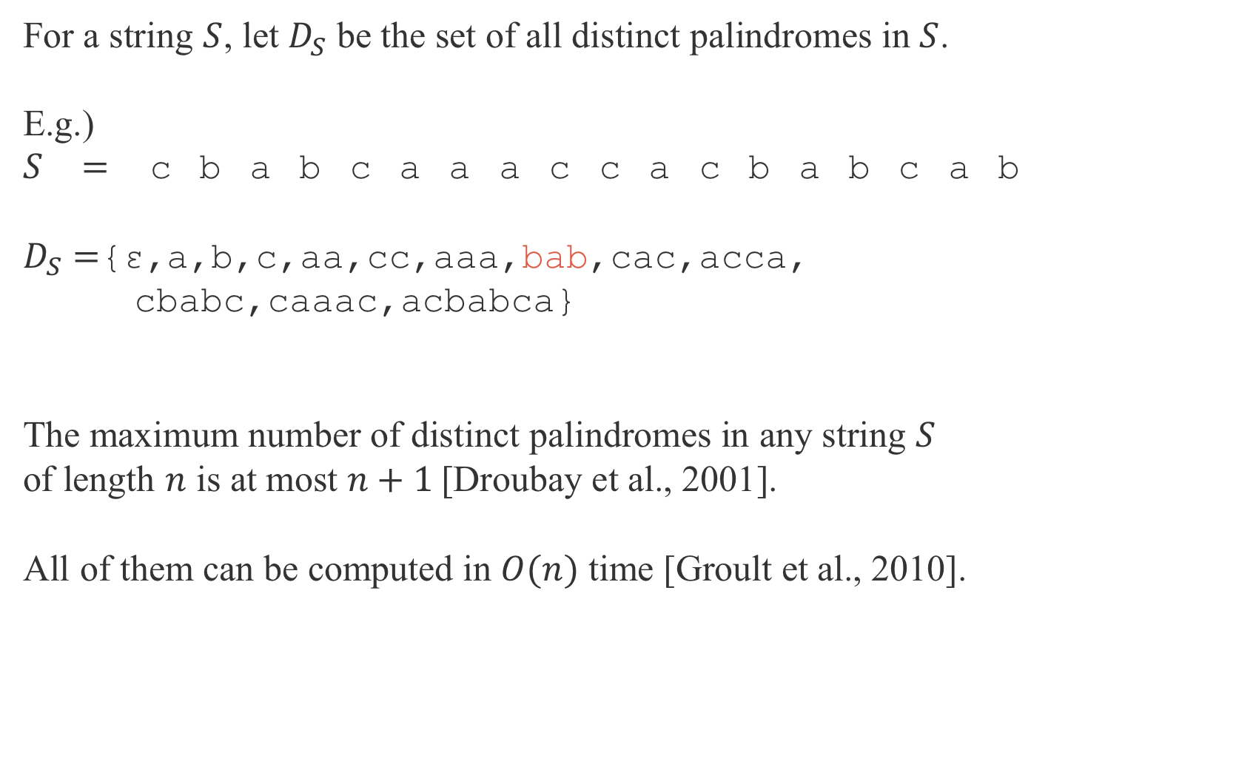
Distinct palindromes in a string
For a string $S$, let $D_{S}$ be the set of all distinct palindromes in $S$.
E.g.)
$S=$ cbabcaaaccacbabcab
$D_{S}=${ε,a,b,c,aa,cc,aaa,bab,cac,acca,
cbabc,caaac,acbabca}
The maximum number of distinct palindromes in any string $S$
of length $n$ is at most $n+1$[Droubay et al., 2001].
All of them can be computed in $O(n)$ time [Groult et al., 2010].
Notes:
Next I will explain distinct palindromes in a string.
For a string $S$, let $D_{S}$ be the set of all distinct palindromes in $S$.
For example, the set of distinct palindromes in this string S is this.
Epsilon is the empty string.
I remark that D_S can contain non maximal palindromes like this.
These are all occurrences of “bab” and both are not maximal palindrome.
The maximum number of distinct palindromes in any string $S$
of length $n$ is at most $n+1$.
Groult et al. proved that all distinct palindromes in $S$ can be computed in linear time.

Slide 8
Trie
A trie is a rooted tree where each edge is labeled by a single char and
out-going edges of each node are labeled by mutually distinct chars.
A trie is a natural extension to a string,
and is a compact representation of a set of strings.
root
a
b
c
c
a
a
a
b
a
b
c
c
b
b
c
b
a
a
d
c
b
a
c
Notes:
We consider palindromes in a trie.
A trie is a rooted tree where each edge is labeled by a single character
and the out-going edges of each node are labeled by mutually distinct characters.
A trie is a natural extension to a string,
and is a compact representation of a set of strings.
Throughout this talk I describe tries like this,
the leftmost white node is the root and gray nodes are leaves.

Slide 9
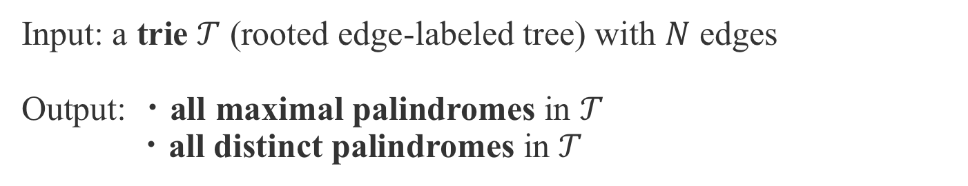
Problem
Input: a trie $𝒯$ (rooted edge-labeled tree) with $N$ edges
Output: ・all maximal palindromes in $𝒯$
・all distinct palindromes in $𝒯$
root
a
b
c
c
a
a
a
b
a
b
c
c
b
b
c
b
a
a
d
c
b
a
c
Notes:
We deal with the following problem.
We are given a trie T with $N$ edges as input.
The output is all maximal palindromes and all distinct palindromes in T.

Slide 10
Pals in a trie (rooted edge-labeled tree)
only consider paths in the root-to-leaf direction
root
a
b
c
c
a
a
a
b
a
b
c
c
b
b
c
b
a
a
d
c
b
a
c
Notes:
I will explain what palindromes in a trie are.
Since we consider a rooted tree, we only consider paths in the root to leaf direction.
だいレクション

Slide 11
Pals in a trie (rooted edge-labeled tree)
only consider paths in the root-to-leaf direction
root
a
b
c
c
a
a
a
b
a
b
c
c
b
b
c
b
a
a
d
c
b
a
c
Notes:
Thus this path labeled by “bccaaccb” is a palindrome in this trie.

Slide 12
Pals in a trie (rooted edge-labeled tree)
only consider paths in the root-to-leaf direction
root
a
b
c
c
a
a
a
b
a
b
c
c
b
b
c
b
a
a
d
c
b
a
c
Notes:
This red string is a palindrome but we do not consider such a path.

Slide 13
Maximal palindromes in a trie
root
a
b
c
c
a
a
a
b
a
b
c
c
b
b
c
b
a
a
d
c
b
a
c
The maximal palindrome centered at is bccaaccb.
Notes:
Next, I will explain maximal palindromes in a trie.
Maximal palindromes in a trie are natural extension of those in a string.
For example, the maximal palindrome centered at this position in this trie is “bccaaccb”.

Slide 14
Maximal palindromes in a trie
root
a
b
c
c
a
a
a
b
a
b
c
c
b
b
c
b
a
a
d
c
b
a
c
The maximal palindrome centered at is aaa.
Notes:
For another example, the maximal palindrome centered at this position in this trie is “aaa”.

Slide 15
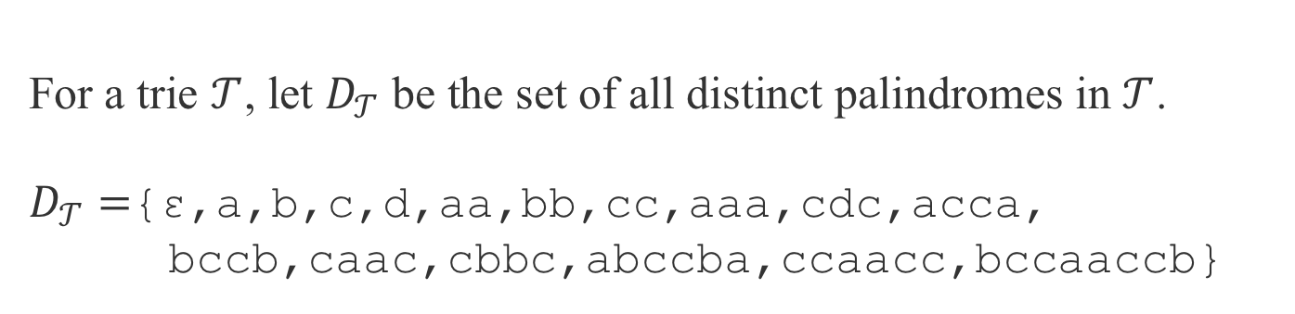
Distinct palindromes in a trie
root
a
b
c
c
a
a
a
b
a
b
c
c
b
b
c
b
a
a
d
c
b
a
c
For a trie $𝒯$, let $D_{𝒯}$ be the set of all distinct palindromes in $𝒯$.
$D_{𝒯}=${ε,a,b,c,d,aa,bb,cc,aaa,cdc,acca,
bccb,caac,cbbc,abccba,ccaacc,bccaaccb}
Notes:
Next, I will explain distinct palindromes in a trie.
For a trie $𝒯$, let $D_{𝒯}$ be the set of all distinct palindromes in $𝒯$.
$D_{𝒯}$ in this trie is this.
As in the case of single string, D_T can contain non maximal palindromes like this.

Slide 16
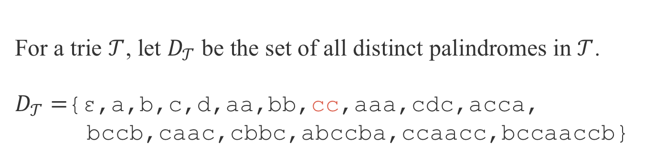
Distinct palindromes in a trie
root
a
b
c
c
a
a
a
b
a
b
c
c
b
b
c
b
a
a
d
c
b
a
c
For a trie $𝒯$, let $D_{𝒯}$ be the set of all distinct palindromes in $𝒯$.
$D_{𝒯}=${ε,a,b,c,d,aa,bb,cc,aaa,cdc,acca,
bccb,caac,cbbc,abccba,ccaacc,bccaaccb}
Notes:
Next, I will explain distinct palindromes in a trie.
For a trie $𝒯$, let $D_{𝒯}$ be the set of all distinct palindromes in $𝒯$.
$D_{𝒯}$ in this trie is this.
As in the case of single string, D_T can contain non maximal palindromes like this.

Slide 17
Distinct palindromes in a trie
root
a
b
c
c
a
a
a
b
a
b
c
c
b
b
c
b
a
a
d
c
b
a
c
For a trie $𝒯$, let $D_{𝒯}$ be the set of all distinct palindromes in $𝒯$.
$D_{𝒯}=${ε,a,b,c,d,aa,bb,cc,aaa,cdc,acca,
bccb,caac,cbbc,abccba,ccaacc,bccaaccb}
Notes:
Next, I will explain distinct palindromes in a trie.
For a trie $𝒯$, let $D_{𝒯}$ be the set of all distinct palindromes in $𝒯$.
$D_{𝒯}$ in this trie is this.
As in the case of single string, D_T can contain non maximal palindromes like this.

Slide 18
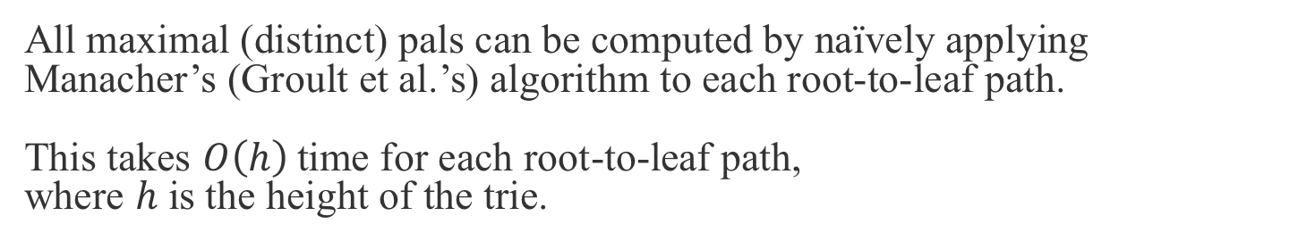
Naïve methods for these problems
root
a
b
c
c
a
a
a
b
a
b
c
c
b
b
c
b
a
a
d
c
b
a
c
All maximal (distinct) pals can be computed by naïvely applying
Manacher’s (Groult et al.’s) algorithm to each root-to-leaf path.
This takes $O\left(h\right)$time for each root-to-leaf path,
where $h$ is the height of the trie.
Notes:
All maximal (distinct) pals can be computed by naïvely applying
Manacher’s (Groult et al.’s) algorithm to each root-to-leaf path.
This takes $O\left(h\right)$time for each root-to-leaf path,
where $h$ is the height of the trie.

Slide 19
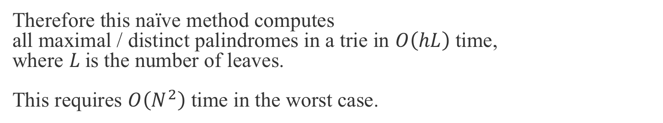
Naïve methods for these problems
root
a
b
c
c
a
a
a
b
a
b
c
c
b
b
c
b
a
a
d
c
b
a
c
Therefore this naïve method computes
all maximal / distinct palindromes in a trie in $O\left(hL\right)$ time,
where $L$is the number of leaves.
This requires $O\left(N^{2}\right)$ time in the worst case.
Notes:
Therefore this naïve method computes
all maximal palindromes and distinct palindromes in a trie in $O\left(hL\right)$ time,
where $L$is the number of leaves.
This requires $O\left(N^{2}\right)$ time in the worst case.

Slide 20
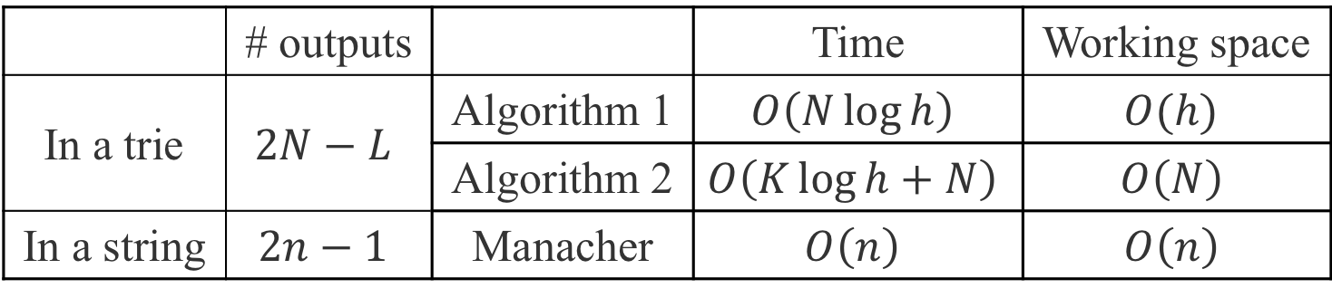
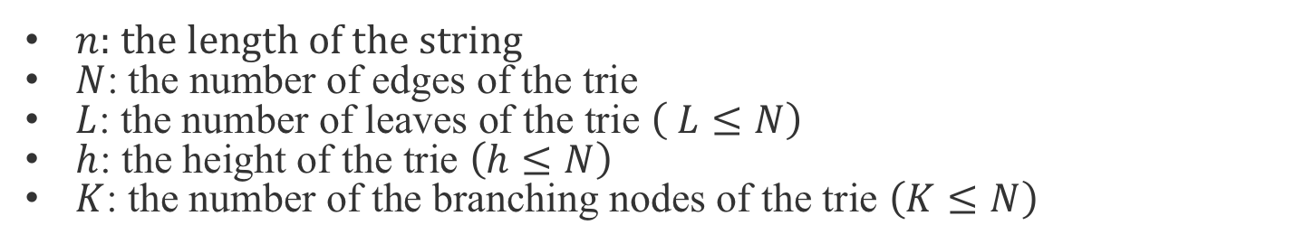
Main results for maximal palindromes
 | # outputs |  | Time | Working space
In a trie | $$2N−L$$ | Algorithm 1 | $$O\left(N\log{h}\right)$$ | $$O(h)$$
 |  | Algorithm 2 | $$O\left(K\log{h}+N\right)$$ | $$O\left(N\right)$$
In a string | $$2n−1$$ | Manacher | $$O\left(n\right)$$ | $$O\left(n\right)$$
$n$: the length of the string
$N$: the number of edges of the trie
$L$: the number of leaves of the trie $\left( L≤N\right)$
$h$: the height of the trie $\left(h≤N\right)$
$K$: the number of the branching nodes of the trie $\left(K≤N\right)$
Notes:
These are results for maximal palindromes.
lower case 𝑛: the length of the string
upper case 𝑁: the number of edges of the trie
𝐿: the number of leaves of the trie ( 𝐿≤𝑁)
ℎ: the height of the trie (ℎ≤𝑁)
𝐾: the number of the branching nodes of the trie (𝐾≤𝑁)
The number of maximal palindromes in a trie is 2N-L.
In a case of single string L is one, so our result generalizes the case of single string.
Then we also showed that all of them can be computed in these time and space.
Because L, h, and K are bounded by upper case N, algorithm 1 and algorithm 2 run in O(N log N) time in the worst case.

Slide 21
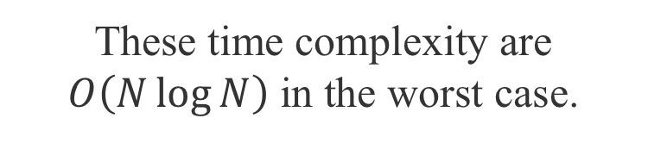

Main results for maximal palindromes
 | # outputs |  | Time | Working space
In a trie | $$2N−L$$ | Algorithm 1 | $$O\left(N\log{h}\right)$$ | $$O(h)$$
 |  | Algorithm 2 | $$O\left(K\log{h}+N\right)$$ | $$O\left(N\right)$$
In a string | $$2n−1$$ | Manacher | $$O\left(n\right)$$ | $$O\left(n\right)$$
These time complexity are $O\left(N\log{N}\right)$ in the worst case.
$n$: the length of the string
$N$: the number of edges of the trie
$L$: the number of leaves of the trie $\left( L≤N\right)$
$h$: the height of the trie $\left(h≤N\right)$
$K$: the number of the branching nodes of the trie $\left(K≤N\right)$
Notes:
These are results for maximal palindromes.
lower case 𝑛: the length of the string
upper case 𝑁: the number of edges of the trie
𝐿: the number of leaves of the trie ( 𝐿≤𝑁)
ℎ: the height of the trie (ℎ≤𝑁)
𝐾: the number of the branching nodes of the trie (𝐾≤𝑁)
The number of maximal palindromes in a trie is 2N-L.
In a case of single string L is one, so our result generalizes the case of single string.
Then we also showed that all of them can be computed in these time and space.
Because L, h, and K are bounded by upper case N, algorithm 1 and algorithm 2 run in O(N log N) time in the worst case.

Slide 22
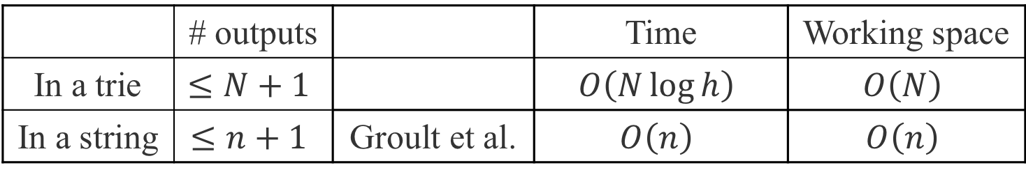
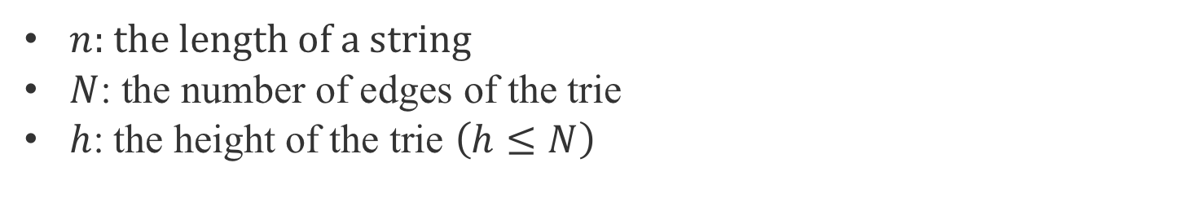
Main results for distinct palindromes
 | # outputs |  | Time | Working space
In a trie | $$≤N+1$$ |  | $$O\left(N\log{h}\right)$$ | $$O\left(N\right)$$
In a string | $$≤n+1$$ | Groult et al. | $$O\left(n\right)$$ | $$O\left(n\right)$$
$n$: the length of a string
$N$: the number of edges of the trie
$h$: the height of the trie $\left(h≤N\right)$
Notes:
These are results for distinct palindromes.
The number of distinct palindromes in a trie is at most N+1.
This result generalizes the case of single string.
All of them can be computed in O(N log h) time and O(N) space.

Slide 23
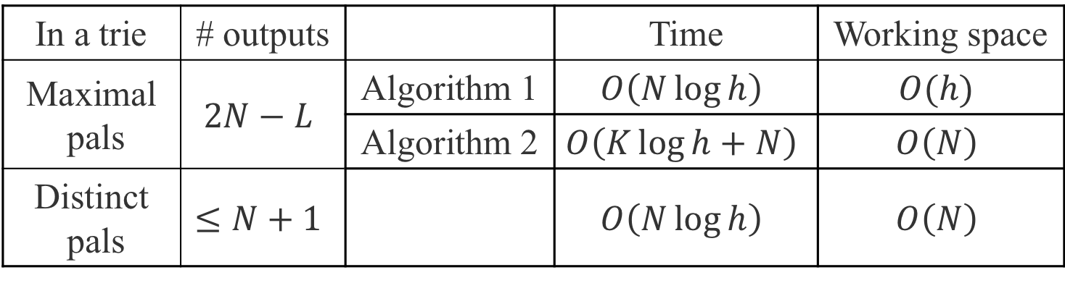
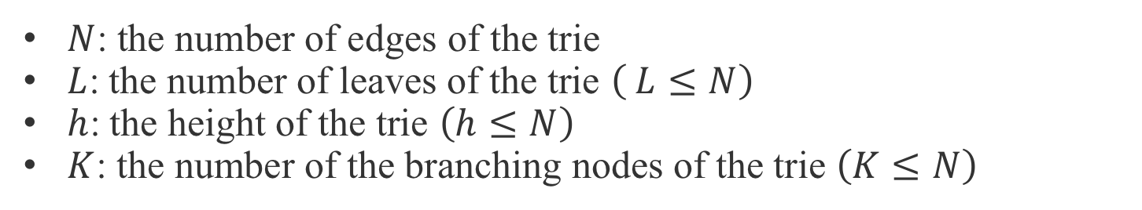
Main results
In a trie | # outputs |  | Time | Working space
Maximal pals | $$2N−L$$ | Algorithm 1 | $$O\left(N\log{h}\right)$$ | $$O(h)$$
 |  | Algorithm 2 | $$O\left(K\log{h}+N\right)$$ | $$O\left(N\right)$$
Distinct pals | $$≤N+1$$ |  | $$O\left(N\log{h}\right)$$ | $$O\left(N\right)$$
$N$: the number of edges of the trie
$L$: the number of leaves of the trie $\left( L≤N\right)$
$h$: the height of the trie $\left(h≤N\right)$
$K$: the number of the branching nodes of the trie $\left(K≤N\right)$
Notes:
In the rest of my talk,
I focus on maximal palindromes and explain these results.

Slide 24
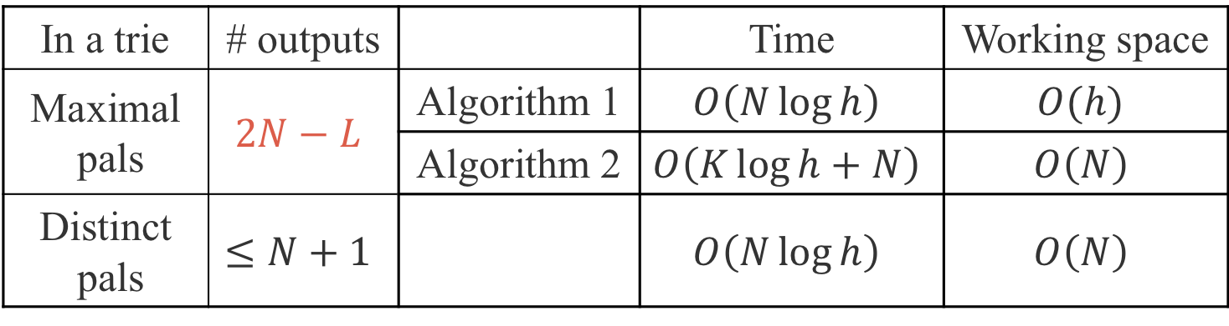
Main results
In a trie | # outputs |  | Time | Working space
Maximal pals | $$2N−L$$ | Algorithm 1 | $$O\left(N\log{h}\right)$$ | $$O(h)$$
 |  | Algorithm 2 | $$O\left(K\log{h}+N\right)$$ | $$O\left(N\right)$$
Distinct pals | $$≤N+1$$ |  | $$O\left(N\log{h}\right)$$ | $$O\left(N\right)$$
$N$: the number of edges of the trie
$L$: the number of leaves of the trie $\left( L≤N\right)$
$h$: the height of the trie $\left(h≤N\right)$
$K$: the number of the branching nodes of the trie $\left(K≤N\right)$
Notes:
First I will explain the number of maximal palindromes in a trie.

Slide 25

The number of maximal palindromes
root
$$u$$
a
b
c
c
a
a
a
b
a
b
c
c
b
b
c
b
a
a
d
c
b
a
c
Notes:
Let’s consider the maximal palindrome of this center position u.
The immediately preceding character is “a” and the immediately following character is “a”.
So this can be extended with the same center like this.

Slide 26
The number of maximal palindromes
root
$$u$$
a
b
c
c
a
a
a
b
a
b
c
c
b
b
c
b
a
a
d
c
b
a
c
Notes:
Then, the immediately preceding character is “c” and the immediately following character is “a” or “c”.
So this can be extended for this edge with the same center like this.

Slide 27
The number of maximal palindromes
root
$$u$$
a
b
c
c
a
a
a
b
a
b
c
c
b
b
c
b
a
a
d
c
b
a
c
Notes:
Then, the immediately preceding character is “c” and the immediately following character is “c”.
So this can be extended with the same center like this.

Slide 28
The number of maximal palindromes
root
$$u$$
a
b
c
c
a
a
a
b
a
b
c
c
b
b
c
b
a
a
d
c
b
a
c
Notes:
Then, the immediately preceding character is “b” and the immediately following character is “a” or “b” or “d”.
So this can be extended for this edge with the same center like this.

Slide 29
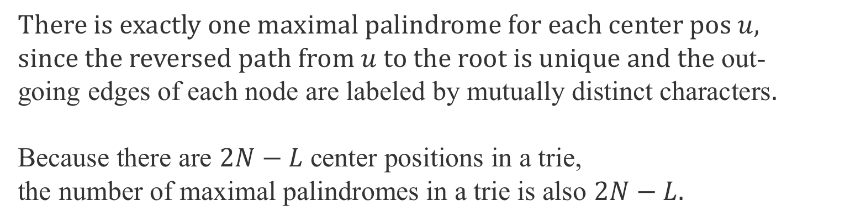
The number of maximal palindromes
root
$$u$$
a
b
c
c
a
a
a
b
a
b
c
c
b
b
c
b
a
a
d
c
b
a
c
There is exactly one maximal palindrome for each center pos $u$,
since the reversed path from $u$ to the root is unique and the out-
going edges of each node are labeled by mutually distinct characters.
Because there are $2N−L$ center positions in a trie,
the number of maximal palindromes in a trie is also $2N−L$.
Notes:
Then, the immediately preceding character is “a” and the immediately following character is “b”.
So this can not be extended with the same center.
As we saw in the example, there is exactly one maximal palindrome for each center position 𝑢,
since the reversed path from $u$ to the root is unique and the out-going edges of each node are labeled by mutually distinct characters.
Since there are N edges,
there are N-L center positions as node and N center positions as edge.
Therefore, the number of maximal palindromes in a trie is exactly $2N−L$.

Slide 30
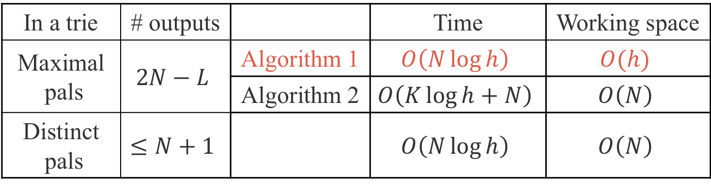
Computing maximal palindromes
In a trie | # outputs |  | Time | Working space
Maximal pals | $$2N−L$$ | Algorithm 1 | $$O\left(N\log{h}\right)$$ | $$O(h)$$
 |  | Algorithm 2 | $$O\left(K\log{h}+N\right)$$ | $$O\left(N\right)$$
Distinct pals | $$≤N+1$$ |  | $$O\left(N\log{h}\right)$$ | $$O\left(N\right)$$
$N$: the number of edges of the trie
$L$: the number of leaves of the trie $\left( L≤N\right)$
$h$: the height of the trie $\left(h≤N\right)$
$K$: the number of the branching nodes of the trie $\left(K≤N\right)$
Notes:
Next I will explain Algorithm 1.

Slide 31
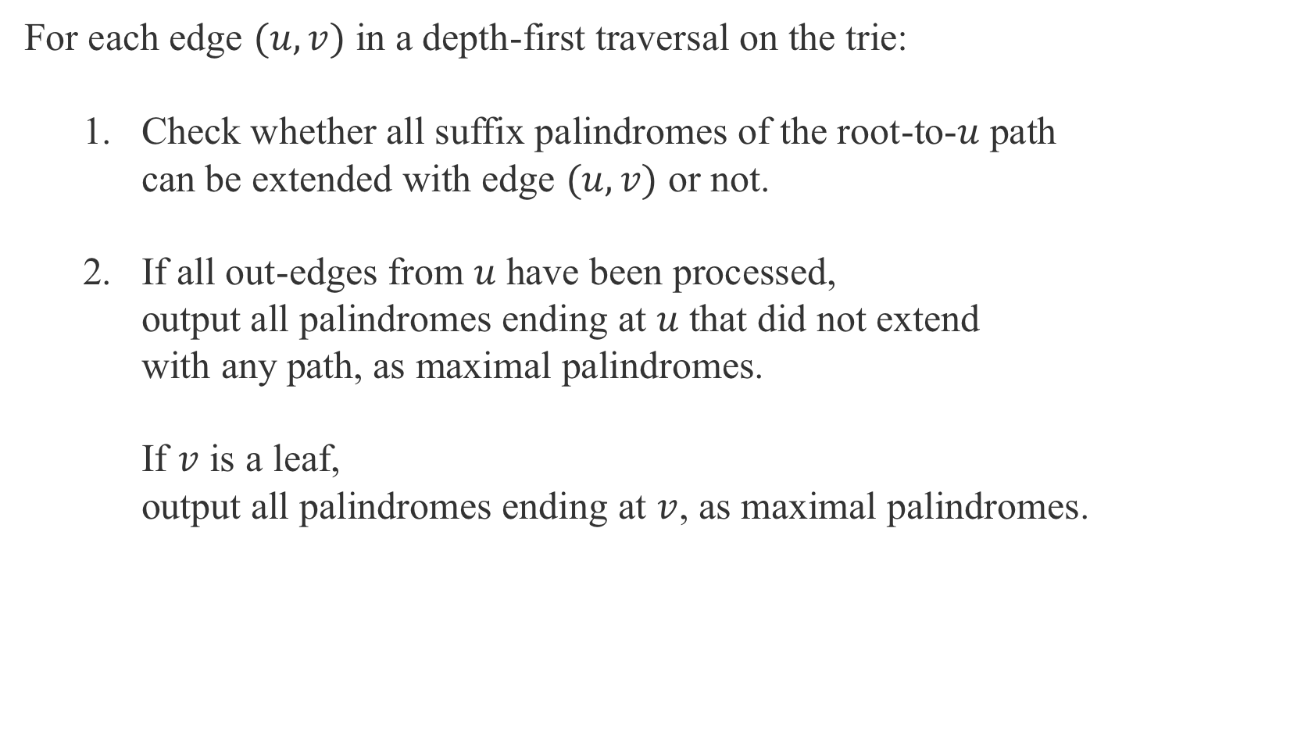
Overview
For each edge $(u, v)$ in a depth-first traversal on the trie:
  Check whether all suffix palindromes of the root-to-$u$ path
  can be extended with edge $(u, v)$ or not.
  If all out-edges from $u$ have been processed,
  output all palindromes ending at $u$ that did not extend
  with any path, as maximal palindromes.
  If $v$ is a leaf,
  output all palindromes ending at $v$, as maximal palindromes.
Notes:
The overview of algorithm 1 is as follows.
For each edge $(u, v)$ in a depth-first traversal on the trie,
check whether all suffix palindromes of the root-to-$u$ path
can be extended with edge $(u, v)$ or not.
If all out-edges from u have been processed,
output all palindromes ending at $u$ that did not extend
with any path, as maximal palindromes.
If v is a leaf,
output all palindromes ending at $v$, as maximal palindromes.

Slide 32



Step 1
For each edge $(u, v)$ in a depth-first traversal on the trie:
  Check whether all suffix palindromes of the root-to-$u$ path
can be extended with edge $(u, v)$ or not.
root
a
b
c
c
a
a
a
b
$$v$$
a
b
$$u$$
c
c
b
b
c
d
c
b
a
a
b
a
c
Notes:
Let’s consider this edge (u,v).
These are suffix palindromes ending at u.

Slide 33
Step 1
For each edge $(u, v)$ in a depth-first traversal on the trie:
  Check whether all suffix palindromes of the root-to-$u$ path
can be extended with edge $(u, v)$ or not.
root
a
b
c
c
a
a
a
b
$$v$$
a
b
$$u$$
c
c
b
b
c
d
c
b
a
a
b
a
c
Notes:
Then, “cc” can be extended for this node v with the same center.

Slide 34


Step 1
For each edge $(u, v)$ in a depth-first traversal on the trie:
  Check whether all suffix palindromes of the root-to-$u$ path
can be extended with edge $(u, v)$ or not.
root
a
b
c
c
a
a
a
b
a
b
$$u$$
c
c
b
b
c
$$v$$
d
c
b
a
a
b
a
c
Notes:
Let's consider another edge.
Then, “ccaacc” can be extended for this node v with the same center.

Slide 35

Step 1
For each edge $(u, v)$ in a depth-first traversal on the trie:
  Check whether all suffix palindromes of the root-to-$u$ path
can be extended with edge $(u, v)$ or not.
root
a
b
c
c
a
a
a
b
a
b
$$u$$
c
c
b
b
c
$$v$$
d
c
b
a
a
b
a
c
Notes:
Let's consider another edge.
Then, these suffix palindromes can not be extended for this node v with the same center.

Slide 36

Step 2
  If all out-edges from $u$ have been processed,
  output all palindromes ending at $u$ that did not extend
  with any path, as maximal palindromes.
root
a
b
c
c
a
a
a
b
a
b
$$u$$
c
c
b
b
c
$$v$$
d
c
b
a
a
Maximal palindrome
b
a
c
Notes:
Now all out-edges from u have been processed,
then we output this “c” as a maximal palindrome.

Slide 37

Suffix palindromes ending at each node
There are $Ω\left(h\right)$suffix palindromes ending at each node.
But we can process them in a total of $O\left(N\log{h}\right)$time and
$O\left(h\right)$working space for all nodes,
by using periodic structures of suffix palindromes.
root
a
b
c
c
a
a
a
b
a
b
c
c
b
b
c
d
c
b
a
a
b
a
c
Notes:
There are $Ω\left(h\right)$suffix palindromes ending at each node.
But we can process them in a total of $O\left(N\log{h}\right)$time and
$O\left(h\right)$working space for all nodes,
by using periodic structures of maximal palindromes.

Slide 38



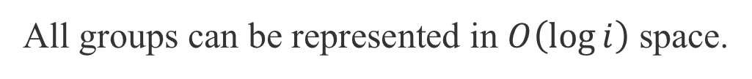

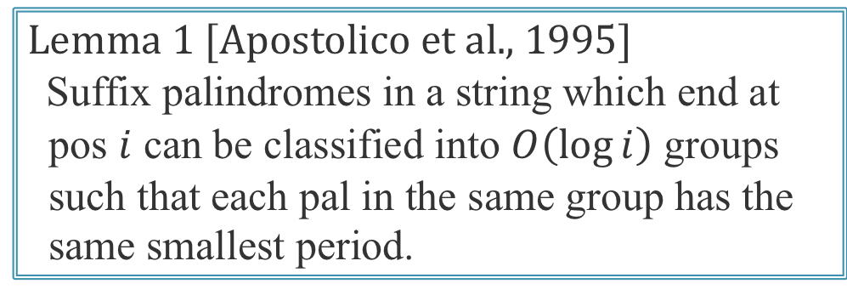

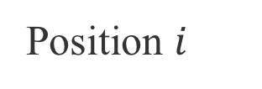


Periodic property of suffix pals in a str.
Position $i$
$\text{a}\text{a}\text{ba}\text{baba}\text{ab}\text{abab}\text{a}\text{abababa}\text{cc}$
$\text{a}\text{abababaabababaabababa}\text{cc}$
$\text{a}\text{abababa}\text{abababaabababa}\text{cc}$
$\text{a}\text{abababaabababa}\text{abababa}\text{cc}$
$\text{a}\text{abababaabababaab}\text{ababa}\text{cc}$
$\text{a}\text{abababaabababaabab}\text{aba}\text{cc}$
$\text{a}\text{abababaabababaababab}\text{a}\text{cc}$
$$p_{1}$$
$$G_{1}$$
$$p_{2}$$
Lemma 1 [Apostolico et al., 1995]
Suffix palindromes in a string which end at
pos $i$ can be classified into $O\left(\log{i}\right)$ groups
such that each pal in the same group has the
same smallest period.
$$G_{2}$$
$$p_{3}$$
$$G_{3}$$
All groups can be represented in $O\left(\log{i}\right)$ space.
Notes:
Let me explain periodic property of suffix palindromes in a string.
these are all the suffix palindromes ending at this position i.
the smallest period of these two palindromes from the top is 7.
so they are in the same group.
the smallest period of these three palindromes in the middle is 2.
so they are in the same group.
finally, the smallest period of the palindrome at the bottom is 1.
so it is in another group.
it is known that the number of these periods is O(log i), so the number of the groups is also O(log i).
All groups can be represented in O(log i) space.

Slide 39



Immediately preceding chars for each group
The maximal palindromes in a group except for the longest one
are immediately preceded by the same character,
since these palindromes have same smallest period.
root
$$u$$
$$v$$
$$G_{i}$$
Notes:
Now I will explain the immediately preceding characters of all maximal palindromes for each group.
From the above, these palindromes have same smallest period.
Therefore, the maximal palindromes in a group except for the longest one
are immediately preceded by the same character.

Slide 40

Immediately preceding chars for each group
The maximal palindromes in a group except for the longest one
are immediately preceded by the same character.
Therefore, the number of distinct immediately preceding characters
for each group is at most 2.
root
$$u$$
$$v$$
$$a$$
b
b
$$G_{i}$$
b
b
Notes:
Therefore, the number of immediately preceding characters for each group is at most 2.

Slide 41
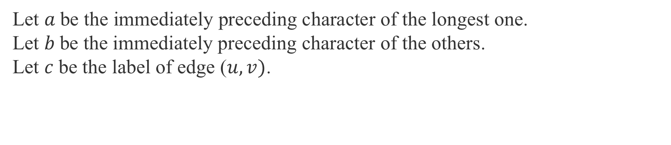
Extension of each group
Let $a$be the immediately preceding character of the longest one.
Let $b$be the immediately preceding character of the others.
Let $c$be the label of edge ($u, v)$.
root
$$u$$
c
$$v$$
$$a$$
b
b
b
b
Notes:
Let $a$be the immediately preceding character of the longest one.
Let $b$be the immediately preceding character of the others.
Let $c$be the label of edge$\left(u,v\right)$.

Slide 42
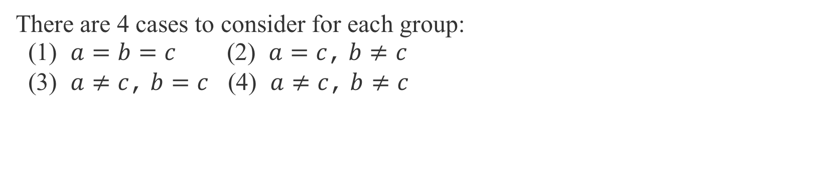
Extension of each group
There are 4 cases to consider for each group:
(1) $a=b=c$ (2) $a=c$,$b≠c$
(3) $a≠c$,$b=c$ (4) $a≠c$, $b≠c$
root
$$u$$
c
$$v$$
$$a$$
b
b
b
b
Notes:
There are 4 cases to consider for each group as follows:

Slide 43
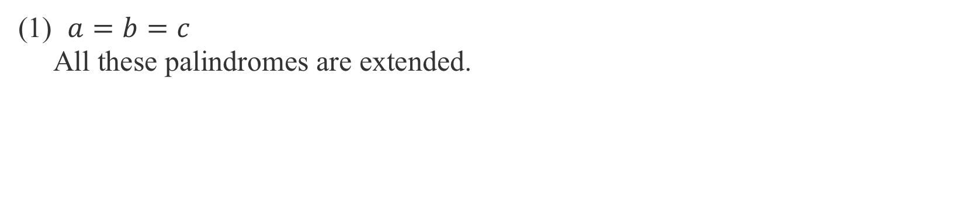
Extension of each group
(1) $a=b=c$
All these palindromes are extended.
root
$$u$$
c
$$v$$
$$a$$
b
b
b
b
Notes:
First, if $a=b=c$, then all these palindromes are extended.

Slide 44
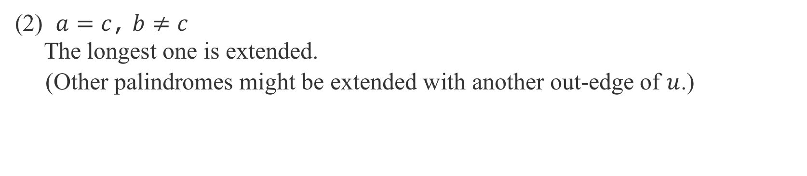
Extension of each group
(2) $a=c$,$b≠c$
The longest one is extended.
(Other palindromes might be extended with another out-edge of $u$.)
root
$$u$$
c
$$v$$
$$a$$
b
b
b
b
Notes:
Second, if$a=c$ $and b≠c$, then the longest one is extended.
Note that, other palindromes might be extended with another out-edge of u.

Slide 45
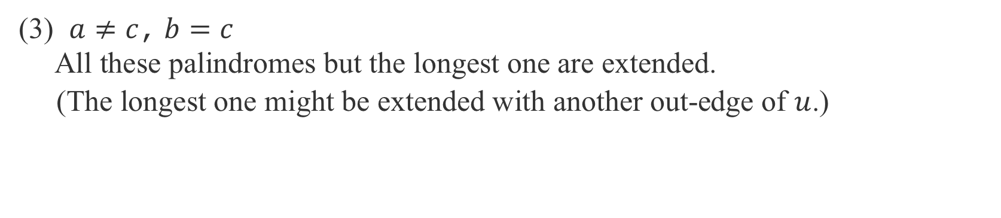
Extension of each group
(3) $a≠c$,$b=c$
All these palindromes but the longest one are extended.
(The longest one might be extended with another out-edge of $u$.)
root
$$u$$
c
$$v$$
$$a$$
b
b
b
b
Notes:
Third, if $a≠c$ a$nd b=c$, then all these palindromes but the longest one are extended.
Same as before, the longest one might be extended with another out-edge of $u$.

Slide 46
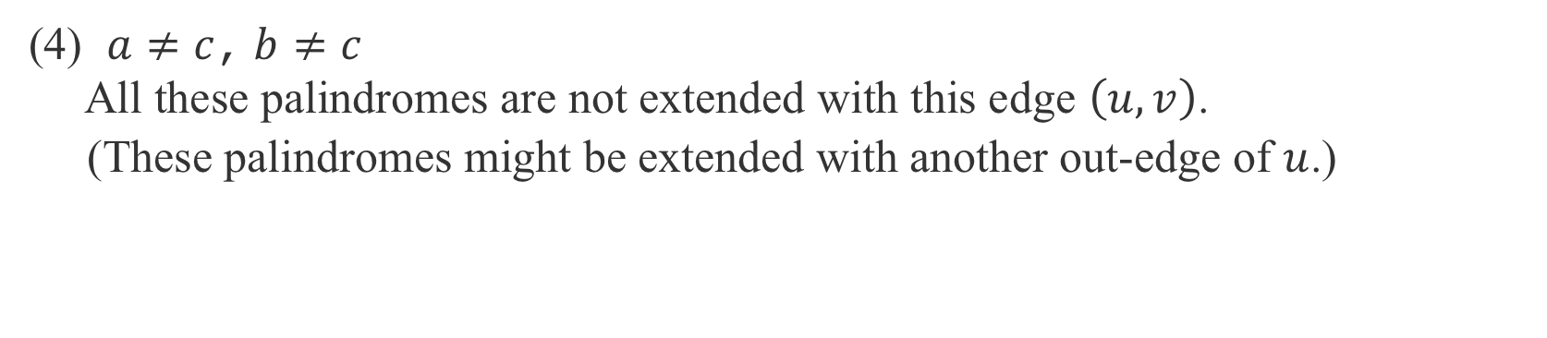
Extension of each group
(4) $a≠c$, $b≠c$
All these palindromes are not extended with this edge $\left(u, v\right)$.
(These palindromes might be extended with another out-edge of $u$.)
root
$$u$$
c
$$v$$
$$a$$
b
b
b
b
Notes:
Finally, $a≠c$ and $b≠c$, then all these palindromes are not extended with this edge (u,v).
These palindromes might be extended with another out-edge of $u$.

Slide 47
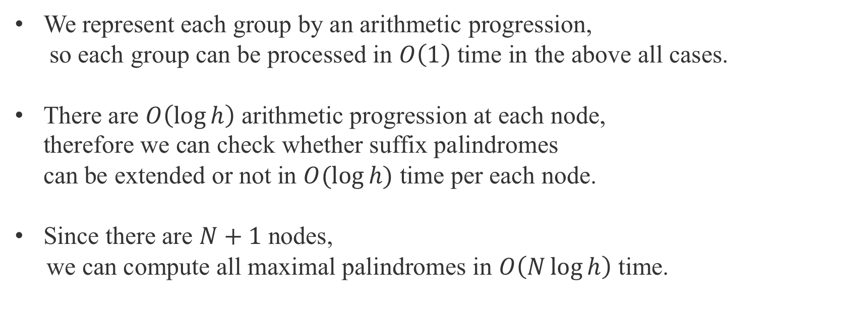
Running time
We represent each group by an arithmetic progression,
so each group can be processed in $O\left(1\right)$ time in the above all cases.
There are $O\left(\log{h}\right)$ arithmetic progression at each node,
therefore we can check whether suffix palindromes
can be extended or not in $O(log⁡h)$ time per each node.
Since there are $N+1$ nodes,
we can compute all maximal palindromes in $O\left(N\log{h}\right)$ time.
Notes:
Let me explain the running time.
We represent each group by an arithmetic progression,
so each group can be processed in constant time in the above all cases.
There are $O\left(\log{h}\right)$ arithmetic progression at each node,
therefore we can check whether suffix palindromes
can be extended or not in $O(log h)$ time per each node.
Since there are $N+1$ nodes,
we can compute all maximal palindromes in $O\left(N\log{h}\right)$ time.

Slide 48



Working space
Since suffix palindromes that are not extended with edge $\left(u, v\right)$
might be extended with another path, we have to store them
during traversal from $u$ to all children of $u$.
These palindromes are maximal in the root-to-$v$ path,
so the working space is $O(h)$ during traversal.
root
$$u$$
$$v$$
a
b
c
c
a
a
a
b
a
b
c
c
b
b
c
b
a
a
d
c
b
a
c
Notes:
Let me explain the working space.
Since suffix palindromes that are not extended with edge $\left(u, v\right)$
might be extended with another path, we have to store them
during traversal from $u$ to all children of $u$.
For example, this suffix palindrome can not be extended with edge (u, v),
but can be extended with another edge.
When we backtrack to u after visiting v, we have to extend this “cc”.
So we cannot discard these suffix palindromes in the root-to-u path during traversal on the root-to-v path.
These palindromes are maximal in the root-to-$v$ path,
so the working space is $O(h)$ during traversal.

Slide 49

Summary
In a trie | # outputs |  | Time | Working space
Maximal pals | $$2N−L$$ | Algorithm 1 | $$O\left(N\log{h}\right)$$ | $$O(h)$$
 |  | Algorithm 2 | $$O\left(K\log{h}+N\right)$$ | $$O\left(N\right)$$
Distinct pals | $$≤N+1$$ |  | $$O\left(N\log{h}\right)$$ | $$O\left(N\right)$$
Notes:
This is a summary of my talk.
We showed these results.

Slide 50
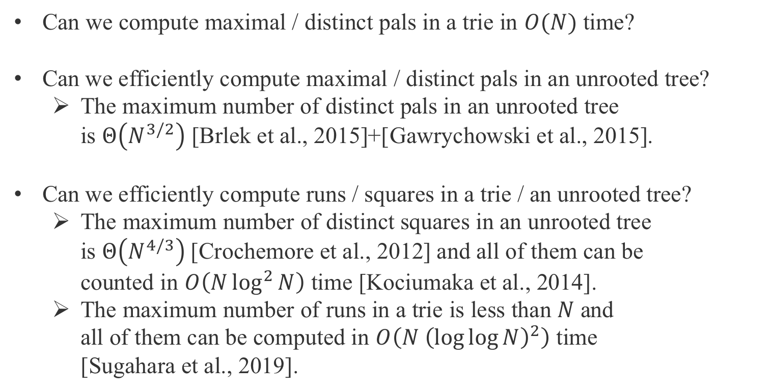
Open problems
Can we compute maximal / distinct pals in a trie in $O(N)$ time?
Can we efficiently compute maximal / distinct pals in an unrooted tree?
  The maximum number of distinct pals in an unrooted tree
  is $Θ\left(N^{3/2}\right)$ [Brlek et al., 2015]+[Gawrychowski et al., 2015].
Can we efficiently compute runs / squares in a trie / an unrooted tree?
  The maximum number of distinct squares in an unrooted tree
  is $Θ\left(N^{4/3}\right)$[Crochemore et al., 2012] and all of them can be
  counted in $O\left(N\log^{2}{N}\right)$ time [Kociumaka et al., 2014].
  The maximum number of runs in a trie is less than $N$ and
  all of them can be computed in $O\left(N {\left(\log{\log{N}}\right)}^{2}\right)$ time
  [Sugahara et al., 2019].
Notes:
These are interesting open problems.
First, Can we compute maximal / distinct palindromes in a trie in $O(N)$ time?
Second, Can we efficiently compute maximal / distinct palindromes in an unrooted tree?
There are previous work on the number of distinct palindromes in an unrooted tree.
The maximum number of distinct pals in an unrooted tree is $Θ\left(N^{3/2}\right)$ (N to three over two) [Brlek et al., 2015]+[Gawrychowski et al., 2015].
Third, Can we efficiently compute runs / squares in a trie / an unrooted tree?
There are previous work.
The maximum number of distinct squares in an unrooted tree
is $Θ\left(N^{4/3}\right)$(N to four over three)[Crochemore et al., 2012] and all of them can be
counted in $O\left(N\log^{2}{N}\right)$ time [Kociumaka et al., 2014].
The maximum number of runs in a trie is less than $N$ and
all of them can be computed in $O\left(N {\left(\log{\log{N}}\right)}^{2}\right)$ time
[Sugahara et al., 2019].
That's all, thank you.

Slide 51
Can we generalize Manachr’s algorithm?
root
a
c
a
a
c
a
a
b
c
b
b
b
c
Notes:
In Manacher's algorithm, the maximal palindrome of this position is copied from the maximal palindrome at a symmetric position with respect to the center position of the longest suffix palindrome and then processed.
However, there are several longest suffix palindromes for each center, and it is not clear which suffix palindrome should be used.
If we process all longest suffix palindromes for each center position,
it requires O (N ^ 2) total time.

Slide 52
Can we generalize Manachr’s algorithm?
root
a
c
a
c
c
a
a
b
c
b
b
b
c
Notes:
In Manacher's algorithm, the maximal palindrome of this position is copied from the maximal palindrome at a symmetric position with respect to the center position of the longest suffix palindrome and then processed.
However, there are several longest suffix palindromes for each center, and it is not clear which suffix palindrome should be used.
If we process all longest suffix palindromes for each center position,
it requires O (N ^ 2) total time.

Slide 53
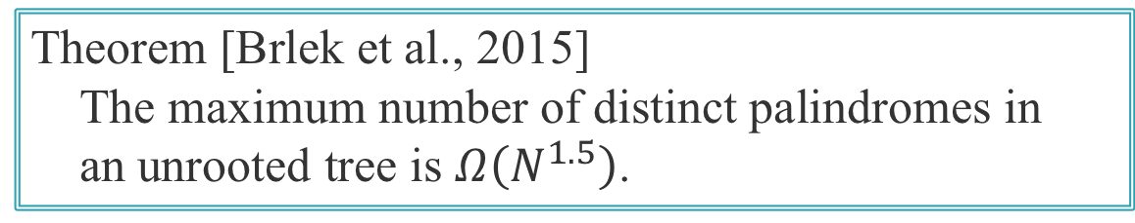
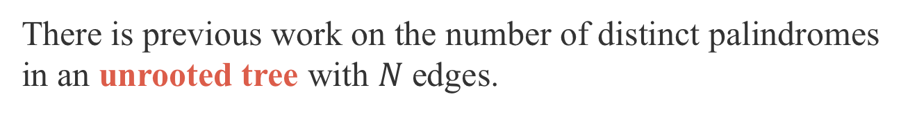
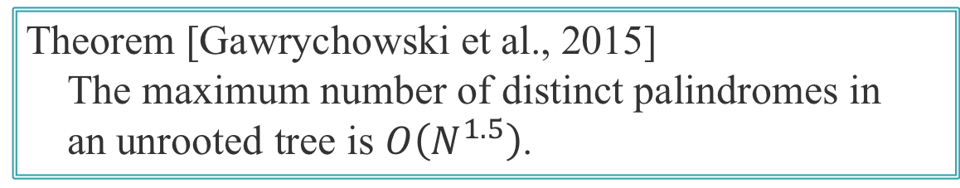
Previous work of palindromes in a tree
There is previous work on the number of distinct palindromes
in an unrooted tree with $N$edges.
Theorem [Brlek et al., 2015]
The maximum number of distinct palindromes in
an unrooted tree is $Ω\left(N^{1.5}\right)$.
Theorem [Gawrychowski et al., 2015]
The maximum number of distinct palindromes in
an unrooted tree is $O\left(N^{1.5}\right)$.
To our knowledge, palindromes in a trie (rooted edge-labeled tree)
have not been studied previously.
Notes:
In addition, there are researches about the number of distinct palindromes
in an unrooted tree with $N$edges.
Brlek et al. gave the lower bound and Gawrychowski et al. showed the upper bound for the maximum number of distinct palindromes in an unrooted tree.
However, in our knowledge, palindromes in a trie (namely, rooted edge-labeled tree)
have not been studied previously.

Slide 54



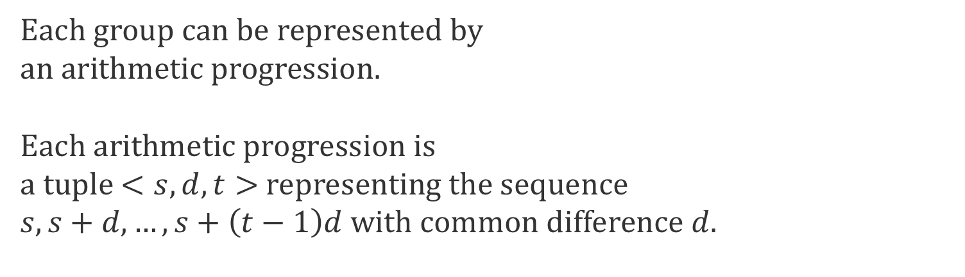

Periodic property of maximal palindromes
Position $i$
$\text{a}\text{a}\text{ba}\text{baba}\text{ab}\text{abab}\text{a}\text{abababa}\text{cc}$
$\text{a}\text{abababaabababaabababa}\text{cc}$
$\text{a}\text{abababa}\text{abababaabababa}\text{cc}$
$\text{a}\text{abababaabababa}\text{abababa}\text{cc}$
$\text{a}\text{abababaabababaab}\text{ababa}\text{cc}$
$\text{a}\text{abababaabababaabab}\text{aba}\text{cc}$
$\text{a}\text{abababaabababaababab}\text{a}\text{cc}$
$$p_{1}$$
$$G_{1}$$
$$<14, 7, 2>$$
$$p_{2}$$
$$G_{2}$$
Each group can be represented by
an arithmetic progression.
Each arithmetic progression is
a tuple $<s, d, t>$representing the sequence
$s, s+d, …, s+\left(t−1\right)d$ with common difference $d$.
$$<3, 2, 3>$$
$$p_{3}$$
$$G_{3}$$
$$<1, 1,1>$$
Notes:
Then each group can be represented by an arithmetic progression.
Each arithmetic progression is a tuple $<s, d, t>$representing the sequence
$s, s+d, …, s+\left(t−1\right)d$ with common difference $d$.
In this example, $G_{1}$ is represented by an arithmetic progression <14, 7, 2>.
14 is the length of the shortest palindrome in $G_{1}$.
7 is equal to the smallest period $p_{1}$.
2 is the number of palindromes in $G_{1}$.

Slide 55
Strategy of Algorithm 2
a
b
a
b
a
a
a
b
a
b
b
a
b
a
c
c
a
b
a
a
b
a
c

Slide 56
Strategy of Algorithm 2
a
b
a
b
a
a
a
b
a
b
b
a
b
a
c
c
a
b
a
a
b
a
c

Slide 57


Strategy of Algorithm 2
a
b
a
b
a
a
a
b
a
b
$r$
$$u$$
b
a
a
c
b
c
a
b
a
a
b
a
c

Slide 58
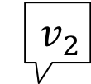
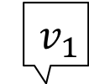
Strategy of Algorithm 2
$$v_{1}$$
a
b
a
b
a
a
a
b
a
b
$r$
$$u$$
b
a
a
c
b
$${ v}_{2}$$
c
a
b
a
a
b
a
c

Slide 59
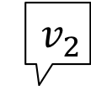


Strategy of Algorithm 2
a
b
a
b
a
a
a
b
a
b
$r$
b
a
a
c
b
$$u$$
$$v_{1}$$
c
a
b
a
a
$${ v}_{2}$$
b
a
c

Slide 60
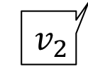
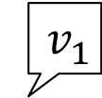
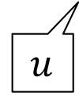
Strategy of Algorithm 2
$$v_{1}$$
a
b
a
b
a
a
a
b
a
b
$r$
$$u$$
b
a
a
c
b
$${ v}_{2}$$
c
a
b
a
a
b
a
c

Slide 61
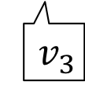
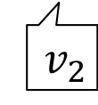


Strategy of Algorithm 2
a
b
a
b
a
a
a
b
$$v_{1}$$
a
b
$r$
b
a
a
c
b
$$u$$
$${ v}_{2}$$
c
a
b
a
a
$${ v}_{3}$$
b
a
c

Slide 62
Strategy of Algorithm 2
a
b
a
b
a
a
a
b
a
b
b
a
b
a
c
c
a
b
a
a
b
a
c

Slide 63
Strategy of Algorithm 2
a
b
a
b
a
a
a
b
a
b
b
a
b
a
c
c
a
b
a
a
b
a
c
All maximal palindromes can be computed
by the above operation.

