Slide 1
Accelerated Partial Decoding in Wavelet Trees
Gilad Baruch⁺, Shmuel T. Klein⁺, Dana Shapiraº
⁺ - Bar Ilan University
º - Ariel University

Slide 2
Agenda
Random Access to Variable Length Coding
Wavelet Trees
Partial Decoding
Naïve
Accelerated
Experimental Results

Slide 3
Random Access to VLC
Fixed Length Coding
i
Variable Length Coding
i

Slide 4
Huffman Trees Example
T = A__HUFFMAN__WAVELET__TREE__MATTERS
Σ = {_,E,A,T,F,M,R,H,L,N,S,U,V,W}
freqs = {8,5,4,4,2,2,2,1,1,1,1,1,1,1}
E(T)= 011 00 00 11001 11101 1010 1010 1011 011
11011 00 00 11111 011 11110 010 11010 …
_
E
A
T
F
M
R
H
L
N
S
U
V
W

Slide 5
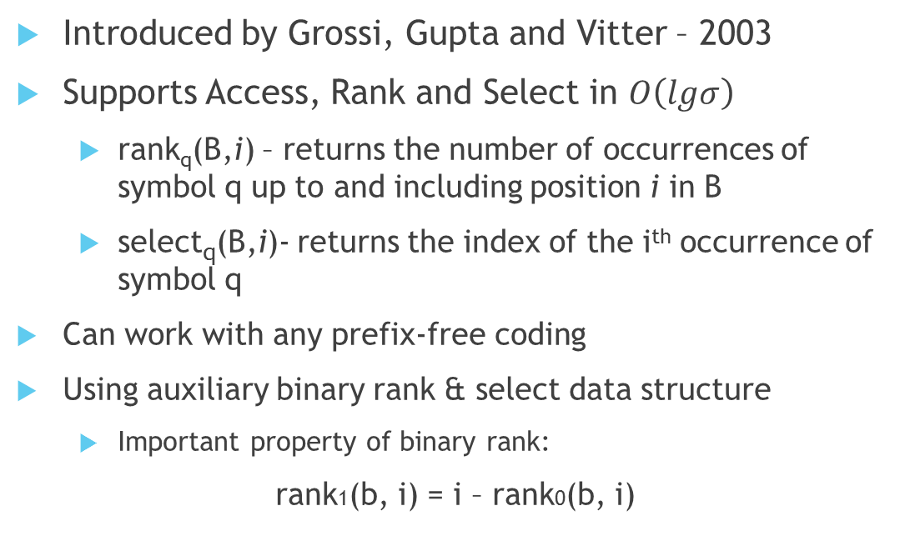
Wavelet Trees
Introduced by Grossi, Gupta and Vitter – 2003
Supports Access, Rank and Select in $O\left(lgσ\right)$
rank_{q}(B,i) – returns the number of occurrences of symbol q up to and including position i in B
select_{q}(B,i)- returns the index of the i^{th} occurrence of symbol q
Can work with any prefix-free coding
Using auxiliary binary rank & select data structure
Important property of binary rank:
rank1(b, i) = i – rank0(b, i)

Slide 6
Wavelet Trees Construction Example
E(T)= 011 00 00 11001 11101 1010 1010 1011 011 11011 00 00 11111 011 11110 010 11010 …
_
A
0
0
1
0
1
_
E
A
T
F
M
R
H
L
N
S
U
V
W

Slide 7
Wavelet Trees Random Access Example
E(T)= 011 00 00 11001 11101 1010 1010 1011 011 11011 00 00 11111 011 11110 010 11010 …
32
rank₁(B_{v},32) = 15
A__HUFFMAN__WAVELET__TREE__MATTERS
rank₁(B_{u},15) = 7
0001111101001010101001100001011011
rank₀(B_{x},7) = 4
rank₀(B_{y},4) = 2
11000111100100011
10010011100110011
111000010
11100100
010110001
_
0011
01100
0110
E
A
T
100
10
10
10
F
M
R
H
L
N
S
U
V
W

Slide 8
Wavelet Trees Random Access Operation
access(V, i){
cw ε
while v is not a leaf
if B_{v}[i] = 0
i rank₀(B_{v}, i)
v left(v)
cw cw⋅0
else
i rank₁(B_{v}, i)
v right(v)
cw cw⋅1
return D(cw)
}

Slide 9
Partial Decoding - Motivation
Retrieving context surrounding the search term
KWIC – KeyWord In Context
Full decoding of the data, in order to obtain the original data

Slide 10
Naïve Partial Decoding
partial_decode(V, i, j){
text ε
for k = i to j
c access(V, k)
text text⋅c
return text
}
full_decode(V){
return partial_decode(V, 0,length(V))
}

Slide 11
Accelerating Partial Decoding
Binary rank operation
Constant time
Most time consuming
Idea
Reuse information of previous decoded characters
How
Store rank values in an additional array of computed nodes

Slide 12
Accelerated Partial Decoding
Despite the O(1) complexity, the binary Rank operation performed on each node is still the most time-consuming operation in the process.
We can save this processing when decoding consecutive characters, by reusing the knowledge we gathered while decoding the previous character.
To do that, we will keep an additional array in the size of the nodes, called rnk, which will store the rank values we computed up to that point.

Slide 13
Accelerated Range Decoding Example
E(T)= 011 00 00 11001 11101 1010 1010 1011 011 11011 00 00 11111 011 11110 010 11010 …
partial_decode(W, 23, 24):
A__HUFFMAN__WAVELET__TREE__MATTERS
rank₀(B_{v},23) = 11
0001111101001010101001100001011011
rank₁(B_{u},11) = 5
10010011100110011
11000111100100011
111000010
11100100
010110001
_
0011
01100
0110
E
A
T
100
10
10
10
F
M
R
H
L
N
S
U
V
W

Slide 14
Accelerated Partial Decoding
partial_decode(V, i, j)
text ε
for k = i to j
c access(V, k)
text text⋅c
return text
An array of |V| elements named rnk is initialized with -1s
if rnk[v] < 0
i rank₀(B_{v}, i)
else
i rnk[v] + 1
rnk[v] i
access(V, i){
cw ε
while v is not a leaf
if B_{v}[i] = 0
i rank₀(B_{v}, i)
v left(v)
cw cw⋅0
else
i rank₁(B_{v}, i)
v right(v)
cw cw⋅1
return D(cw)
}
if rnk[v] < 0
rnk[v] rank₀(B_{v}, i)
i i – rnk[v]
else
i i – rnk[v] + 1

Slide 15
Experimental Results
The results gathered are for full decoding.
We produce the results over different variants of wavelet trees and rank support, all gave basically the same results.
File | Size (MB) | |∑| | Processing Time (Seconds) |  | Ratio
 |  |  | Traditional | Accelerated
ebib | 3.5 | 53 | 0.66 | 0.27 | 0.40
English | 200 | 225 | 28.21 | 12.32 | 0.44
ftxt | 7.6 | 132 | 1.87 | 0.72 | 0.38
DBLP | 200 | 96 | 36.52 | 16.42 | 0.45

Slide 16
Questions?

